Slide 1
Week 8

Slide 2
Monday

Slide 3
Standard: have Night books ready to finish chapter 5 and 6. You’ll also need your study guide

Slide 4
Week 8:
Monday, 10/16
Grammar Rule: A complex sentence contains one independent clause and a least one subordinate clause.
Example (do not copy): When they had finished their word, they complimented each other on the results.

Slide 5
Sentence Correction
Copy the following sentence, correct if necessary, underline the clause(s), and identify the clauses.
When he addressed the jury, the lawyer tried to ease their ambivalent feelings towards his client.

Slide 6
Vocabulary
AMBIVALENT- having opposing feelings; uncertain
CAMARADERIE- goodwill among friends

Slide 7
Night Test
After you finish the test, begin working on response question 8:
“Choose one of the following literary terms: motif, personification, and hyperbole to answer the next question. How was Elie able to effectively explain what happened to him using this device? Why is figurative language so helpful in explaining different situations?”
Draw a symbol that represents how Elie has changed throughout the story
Make sure you have response questions 1-3, 6 and 8 completed by tomorrow!

Slide 8
Tuesday

Slide 9
Week 8:
Tuesday, 10/17
Grammar Rule: If the subordinate clause precedes the independent clause, place a comma between the clauses (there are a few exceptions).
Example (do not copy): After we had finished our article, we took it to the editor of the school newspaper.

Slide 10
Sentence Correction
Copy the following sentence, correct if necessary, underline the clause(s), and identify the clauses.
When he saw the array of colors in his wife’s outfit Paul’s enigmatic expression could not be hidden.

Slide 11
Vocabulary
CURTAIL- to cut short
ENIGMATIC- puzzling

Slide 12
Wednesday

Slide 13
Week 8:
Wednesday, 10/18
Grammar Rule: In a complex sentence the subordinate clause may follow the independent clause. If it does, no comma is necessary.
Example (do not copy): The hotel guests were surprised when the alarm went off.

Slide 14
Sentence Correction
Copy the following sentence, correct if necessary, underline the clause(s), and identify the clauses.
It seemed as though the game was going to last for years, because the languid players couldn’t score points.

Slide 15
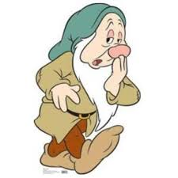
Vocabulary
HAUGHTY -snobbish; overly proud
LANGUID -lacking energy or spirit

Slide 16
Thursday

Slide 17
Week 8:
Thursday, 10/19
Grammar Rule: Use your list of common subordinating conjunctions to help you identify the beginning of subordinating clauses.
Example (do not copy): Because John liked to take photos, Harriet appointed him the official vacation photographer.

Slide 18
Sentence Correction
Copy the following sentence, correct if necessary, underline the clause(s), and identify the clauses.
Harriet reproached her players after they gave up a 20 point lead in the 4th quarter of the game.

Slide 19
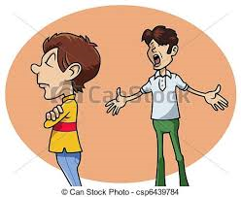
Vocabulary
REPROACH- to criticize or express disappointment
VACILLATE -to be undecided, to hesitate

