Slide 1
Week 7

Slide 2
Week 7:
Monday, 10/9
Grammar Rule: A clause is a word group that contains a verb and its subject and that is used as a sentence or part of a sentence.
independent clause: expresses a complete thought and can stand by itself
subordinate (dependent) clause: does not express a complete thought and cannot stand alone as a sentence

Slide 3
Sentence Correction
Copy the following sentence, correct if necessary, underline the clause(s), and identify the clauses.
Because of the altruistic treatment the nurse gave her patients she received an exemplerary award.

Slide 4
Vocabulary
ALTRUISTIC- unselfishly concerned for the welfare of others
CAJOLE- to persuade by flattery

Slide 5
Tuesday

Slide 6
Welcome
Make sure phones are away, pencils are sharpened, and you are in your seat when the bell rings.
Honors: We will complete the warm up before you take the quiz. Turn in your study guide.
Standard: Have your warm up and Night books on your desk.
Phones should be off your desk and NO FOOD.

Slide 7
Week 7:
Tuesday, 10/10
Grammar Rule: A sentence: can be classified, depending on its structure, as simple, compound, complex, or compound complex.
A simple sentence: contains one independent clause and no subordinate clauses.
Example (do not copy): Cora and Kareem bought party supplies at the mall.

Slide 8
Sentence Correction
Copy the following sentence, correct if necessary, underline the clause(s), and identify the clauses.
The mom gave a cursory glance to her child’s report card.

Slide 9
Vocabulary
CURSORY- performed with haste and little attention to detail
ENCROACH- to advance beyond limits

Slide 10
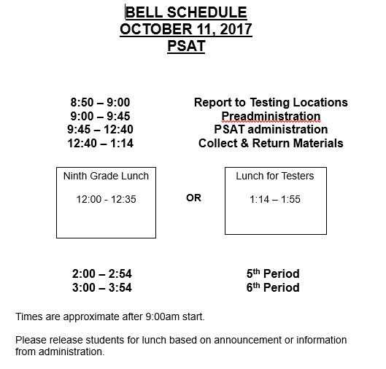
PSAT
Note that you will attend 5th and 6th period
The PSAT is for 10th and 11th graders. If you are still labeled as a 9th grader in PS, you will not take this exam.
Blue sheet outside has the room number you will report to tomorrow morning
Be on time! After we begin, you can not enter.
If you did not fill out the slip to request a calculator, you will not get one. Juniors have priority; the PSAT can be completed without a calculator. Bring ID and calculator if you have one.

Slide 11
Week 7:
Wednesday, 10/11
Grammar Rule: Compound sentences contain two or more independent clauses and no subordinate clauses.
Example (do not copy): Cora hung colorful streamers from the ceiling, and Kareem set party favors on the tables.

Slide 12
Sentence Correction
Copy the following sentence, correct if necessary, underline the clause(s), and identify the clauses.
Gareth lamented over his recent break-up with his girlfriend and he came up with a plan to apologize to her.

Slide 13
Vocabulary
HARANGUE- a long, angry speech
LAMENT -to regret; to show grief for

Slide 14
Week 7:
Thursday, 10/12
Grammar Rule: A compound sentence is two or more independent clauses joined together by:
a comma and a coordinating conjunction,
a semicolon, or
a semicolon and a conjunctive adjective followed by a comma.

Slide 15
Sentence Correction
Copy the following sentence, correct if necessary, underline the clause(s), and identify the clauses.
The utilitarian backpack was very useful on the camping trip for the boy scouts had everything they needed for survival.

Slide 16
Vocabulary
RELINQUISH- to give up; to release
UTILITARIAN- having only a useful function; practical

