Slide 1
Week 6

Slide 2
Week 6: Monday, 10/2
Grammar Rule: A run-on sentence: is two or more complete sentences that are written as one sentence.
Example (do not copy): As he jogged across the street, he was nearly hit by an incompetent driver the jogger managed to dodge away in time.

Slide 3
Sentence Correction
Copy and correct the following run-on sentence:
When the music teacher heard the cacophony of sounds, she was instantly disheartned she knew it was going to take a lot of work to get her studetns to sound like a band.

Slide 4
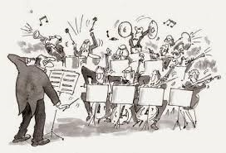
Vocabulary
AESTHETIC- concerning beauty
CACOPHONY- jarring, disagreeable sound

Slide 5
Welcome
Make sure phones are away, pencils are sharpened, and you are in your seat when the bell rings.
Honors: Turn in your Polish boy poem homework
Phones should be off your desk and NO FOOD.

Slide 6
Week 6:
Tuesday, 10/3
Grammar Rule: A fused sentence: is where the writer has joined two or more sentences without punctuation.
Example (do not copy): Measurements originally were related to the sizes of people’s hands, arms, and feet an inch was once defined as the width of a thumb.

Slide 7
Sentence Correction
Copy and correct the following run-on sentence:
The student received a failing grade on his paper for not having credible sources he also had to meet with his professor afterwards.

Slide 8
Vocabulary
CREDIBLE- believable
ELUCIDATE- to make clear

Slide 9
Week 6:
Wednesday, 10/4
Grammar Rule: A comma splice: is where the writer has joined two or more sentences with a comma to separate them.
Example (do not copy): A foot was the length of person’s foot, a yard was the distance from a person’s nose to the end of his thumb when his arm was outstretched.

Slide 10
Sentence Correction
Copy and correct the following run-on sentence:
On the show “Shark Tank,” the millionares are known for their keenness, they are able to decide “on the spot” whether products will be profitable and popular with consumers.

Slide 11
Vocabulary
HAMPER- to prevent the movement or action of
KEEN- sharp, perceptive

Slide 12
Week 6:
Thursday, 10/5
Grammar Rule: Revise run-on sentences by:
adding a comma and coordinating conjunction (FANBOYS);
adding a semicolon;
adding a semicolon, conjunctive adjective (therefore, instead, meanwhile, still, also, nevertheless, or however), and a comma; or
adding a period.

Slide 13
Sentence Corrections
Copy and correct the following run-on sentence:
The greedy Macbeth usurped the kingdom away from its rightful owner however he is unable to keep the power for long.

Slide 14
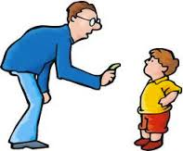
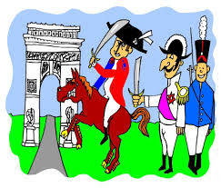
Vocabulary
REBUKE to criticize or find fault with
USURP- to seize and take control without authority and possibly with force

