Slide 1
Week 5

Slide 2
Welcome
Make sure phones are away, pencils are sharpened, and you are in your seat when the bell rings.
Honors –
Standard –

Slide 3
Week 5: Monday, 9/25
Grammar Rule: Complete sentences: must have a subject, have a verb, and express a complete thought.
Example (do not copy): A tarantula is a large, hairy spider.

Slide 4
Sentence Correction
Copy and correct the following sentence:
The actor mad because he did not receive adulation from the fans at the end of the show.

Slide 5
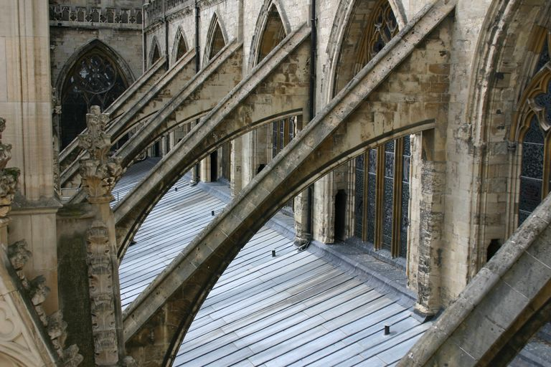
Vocabulary
ADULATION- excessive flattery
BUTTRESS- to support or strengthen

Slide 6
Week 5: Tuesday, 9/26
Grammar Rule:
Sentence fragment: a group of words that is only part of a sentence and should be corrected to be a complete sentence.
Example (do not copy): Some tarantulas of South America to a body length of 3 ½ inches.
Corrected: Some tarantulas of South America grow to a body length of 3 ½ inches.

Slide 7
Sentence Correction
Copy and correct the following sentence:
Because he felt an effusive love for the princess, he diamond ring to impress her and hopefully win her affection.

Slide 8
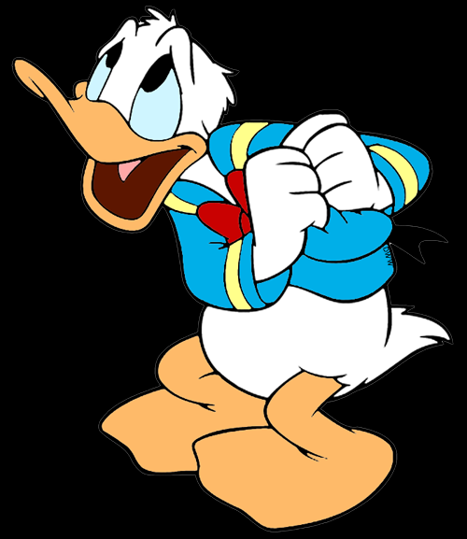
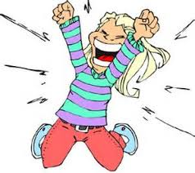
Vocabulary
CONTRITE- feeling or expressing remorse
EFFUSIVE -overflowing (usually referring to emotions)

Slide 9
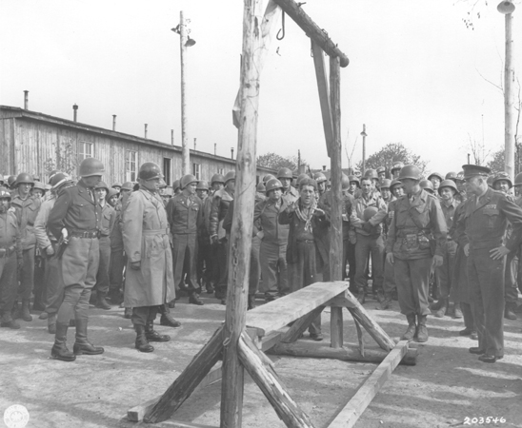
Night Response Booklet

Slide 10
Response Booklet
Directions 1.Create your booklet. You will need two sheets of construction paper and 9 sheets of notebook paper.
2. Every day, during the last ten minutes of class, you will write a one page response for the question posted. 3. Provide your honest opinion! Be sure to include textual evidence to support those opinions!
4. All Reponses must include at least one in-text citation. Rubric
Entries explain why, rather than summarize.
Entries focus on scenes read for that day, and use the text as evidence in the explanation given.
Entries are at least a page long.
Entries are neat, legible, and mechanically correct.

Slide 11
Note to Teacher: Booklets
Each time a chapter is completed, provide the response question for students to complete during class or for homework.
Response booklets are usually due at the end of a unit unless the teacher will want to set a check point date at which student progress will be monitored.
Response questions can also provide great in depth class discussions to help students understand difficult concepts or thoughts they may have at the end of a chapter.
Response booklets can be given to both honors classes as well as standard. Length may be shortened for standard classes.
The questions can be given after every individual chapter or all together as a handout for students to complete if they choose to read ahead.

Slide 12
Booklet Example

Slide 13
Booklet Example

Slide 14
Week 5: Wednesday, 9/27
Grammar Rule:
A phrase: is a group of words that does not contain a subject and a verb. A phrase by itself is a fragment.
Example (do not copy): Our class interested in deserts. Corrected: Our class was interested in deserts.

Slide 15
Sentence Correction
Copy and correct the following sentence:
The gregarious sorority sisters who loved each other.

Slide 16
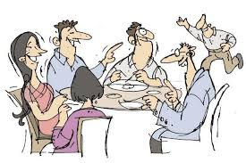
Vocabulary
GREGARIOUS- sociable
JUXTAPOSE- to place side by side

Slide 17
Week 5:
Thursday, 9/28
Grammar Rule:
A clause: is a group of words that has a subject and a verb
Independent clause: is a complete thought and can stand alone as a sentence.
Subordinate (dependent) clause: does not express a complete thought and is a fragment.
Example (do not copy): When flocks of scarlet ibises come to roost in the mangrove trees of the Caroni Swamp. ( subordinate clause...not a complete thought)

Slide 18
Sentence Correction
Copy and correct the following sentence:
Because their daughter’s boyfriend was extremely urbane.

Slide 19
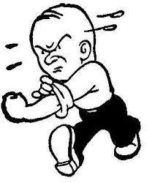
Vocabulary
RANCOR- hostility
URBANE- polite, suave, and cultivated in manner

