Slide 1
Week 4 Warm Ups

Slide 2
Welcome
Make sure phones are away, pencils are sharpened, and you are in your seat when the bell rings.
Honors – “On Seeing England for the First Time” Work – Have it on your desk.
Standard – “Funny in Farsi” work
Tutoring Wednesday
Narrative Assessment and Warm Up Quiz Friday

Slide 3
Week 4: Monday, 9/18
Grammar Rule/Part of Speech: Prepositions: words that show the relationship of a noun or pronoun, called the object of the preposition, to another word.
Example (do not copy): I rode past the village, through the woods, towards the city and near the sea.

Slide 4
Sentence Correction
Copy and correct the following sentence by adding appropriate prepositions:
The young man admonished his friend for sneaking ______ the complex. He thought it was risky for his friend to climb ______ a wall and crawl _______ the shrubbery to gain access.

Slide 5
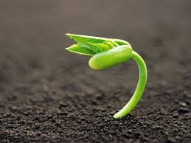
Vocabulary
ADMONISH- to gently criticize or warn
BURGEON- to grow

Slide 6
Week 4: Tuesday, 9/19
Grammar Rule/Part of Speech:
Conjunctions: join words and word groups
Coordinating Conjunctions: join words or word groups that are used in the same way (FANBOYS)
Example (do not copy): We can walk to the neighborhood pool or to the park.

Slide 7
Conjunctions (Correlative)
Grammar Rule/Part of Speech:
Correlative Conjunctions: pairs of conjunctions that join words or word groups that are used in the same way.
Example (do not copy): Neither the baseball team nor the soccer team has practice today.

Slide 8
Sentence Correction
Copy the following sentence and correct by adding conjunctions.
_________ the eccentric designer ______ the client felt that the dress needed more pizzaz _____ flare to wow the wedding guests.

Slide 9
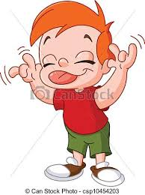
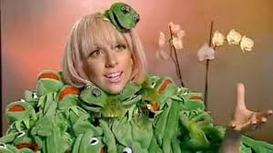
Vocabulary
CONTEMPT- a lack of respect and intense dislike
ECCENTRIC- strange; unconventional

Slide 10
Week 4: Wednesday, 9/20
Grammar Rule/Part of Speech: Subordinating Conjunctions: conjunctions that are used at the beginning of subordinating clauses to connect unequal parts.
Example (do not copy): After the rainstorm, he had to go out into the yard to pick up debris because it was blocking his driveway.

Slide 11
Sentence Correction
Copy the following sentence and correct by adding the appropriate subordinating conjunction.
________ the garrulous students refused to quiet down, the teacher decided to give them a pop quiz on the notes.

Slide 12
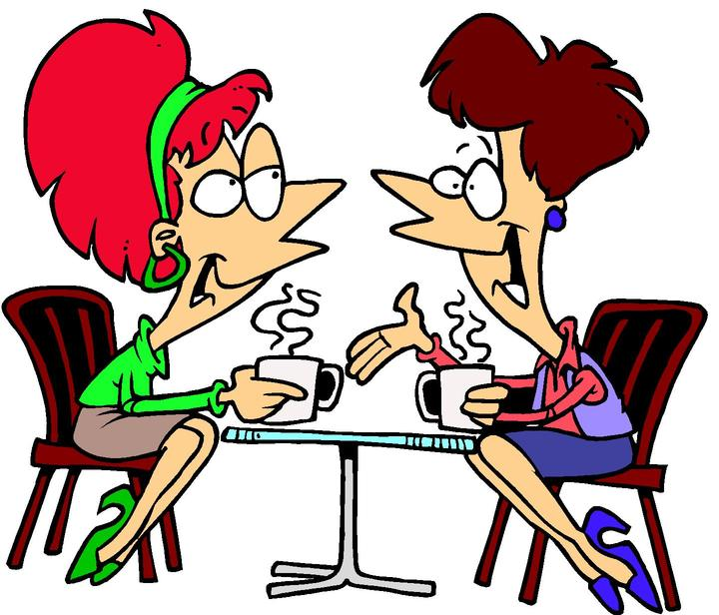
Vocabulary
GARRULOUS-talkative
INVOKE- to enforce or put into operation

Slide 13
Week 4: Thursday, 9/21
Grammar Rule/Part of Speech: Interjections: express emotion. They have no grammatical relation to the rest of the sentence.
Example (do not copy): Well, I’m just not sure.

Slide 14
Sentence Correction
Copy and correct the following sentence by adding an appropriate interjection:
______! The unassuming robber was able to steal a ton of clothes without ever being noticed or caught.

Slide 15
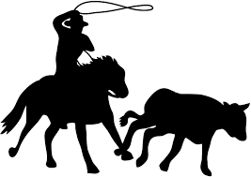
Vocabulary
QUELL- to put down forcibly
UNASSUMING -not showy or arrogant; modest; plain

