Slide 1
Week 3 PPT

Slide 2
Welcome
You should be in your seat when the bell rings with pencils sharpened and phones away.
Honors – Turn in to me your Kanye West article analysis AND the two emails.
If you were absent Friday, you need to make up the warm up quiz Wednesday after school.
We will talk about summer reading

Slide 3
Week 3: Monday, 9/11
Grammar Rule/Part of Speech:
Indefinite pronouns refer to a person, place, thing, or idea that may or may not be specifically named.
Example: (do not copy)
Everything we will need is packed in the trunk.

Slide 4
Sentence Correction
Copy the following chart.

Slide 5
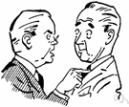
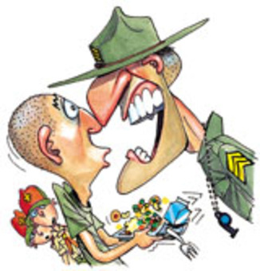
Vocabulary
ACRIMONY- hostility
BRUSQUE - rudely brief

Slide 6
“Imagine” by John Lennon Annotation
1. What is the subject matter of the song?
2. What is the tone of the song (use one from your tone list)? In other words, how does John Lennon feel about the subject of the song?
3. Give three examples of diction that support your tone list. Can underline.
4. What are two interesting lines you found? Annotate on the side why they are interesting to you.

Slide 7
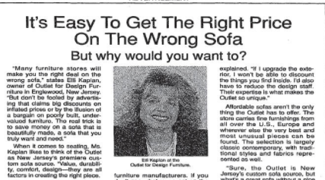
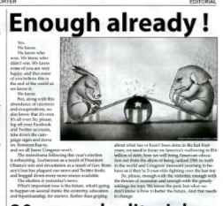
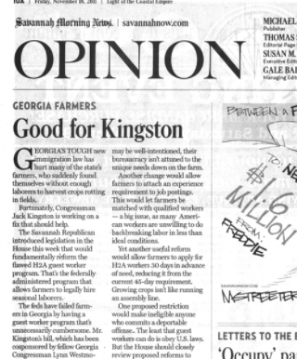

Slide 8
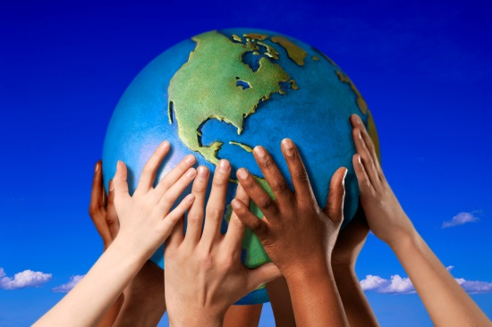
As a group, write an editorial about the likelihood of acquiring world peace with your assigned tone. Use examples, analogies, creative language, etc.

Slide 9
In your groups, be sure to:
Make sure that your editorial is a solid paragraph (5-7 sentences); it would be nice if your editorial had a topic sentence that directly addressed the topic of world peace in your assigned tone. Have a catchy title.
Check that your diction and punctuation illustrate your assigned tone
Write all group members’ names and your assigned tone on the back of the paper
Your tone word is a SECRET

Slide 10
1. Reading Notes
a. What are two factors that shape who you are (make your voice)? (par. 2)
b. In writing and speaking, voice is conveyed in what four ways? (par. 4)
c. What does an author’s voice imply? (par. 6)
d. Writing with voice not only can represent the individual but a __________. (par. 7)
e. This is shared by more than one person and features voice (par. 8)

Slide 11
Honors
Do not tell other groups your tone word; it is a secret in waiting.

Slide 12
Week 3: Tuesday, 9/12
Grammar Rule/Part of Speech:
Adjectives: modify a noun or a pronoun. They tell what kind, which one, how many, or how much.
Articles: most frequently used adjectives: a, an, the
Example: (do not copy) A friendly park ranger helped us find the new campsite.

Slide 13
Sentence Correction
Copy the following sentence and underline the adjectives and articles.
The overenthusiastic student could not seem to construe the meaning of the detailed problem found in her purple, algebra book.

Slide 14
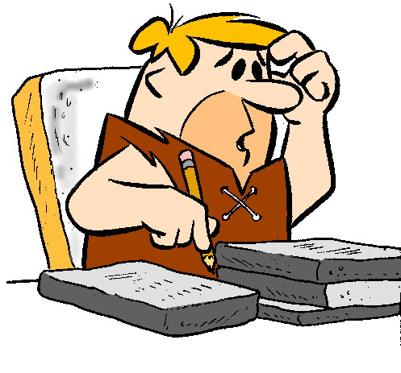
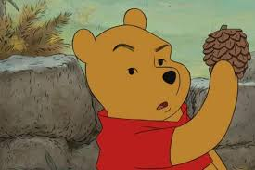
Vocabulary
CONSTRUE- to interpret
DUBIOUS- doubtful, questionable

Slide 15
Week 3: Wednesday, 9/13
Grammar Rule/Part of Speech:
Verbs: express action or a state of being
Example (do not copy): They imagined what would happen if their fingers froze to the keys of their instruments.

Slide 16
Sentence Correction
Copy the following sentence and underline the verbs.
She was going to forget the entire thing, but then she decided to instigate trouble between her ex-boyfriend and his new girlfriend who were falling in love.

Slide 17
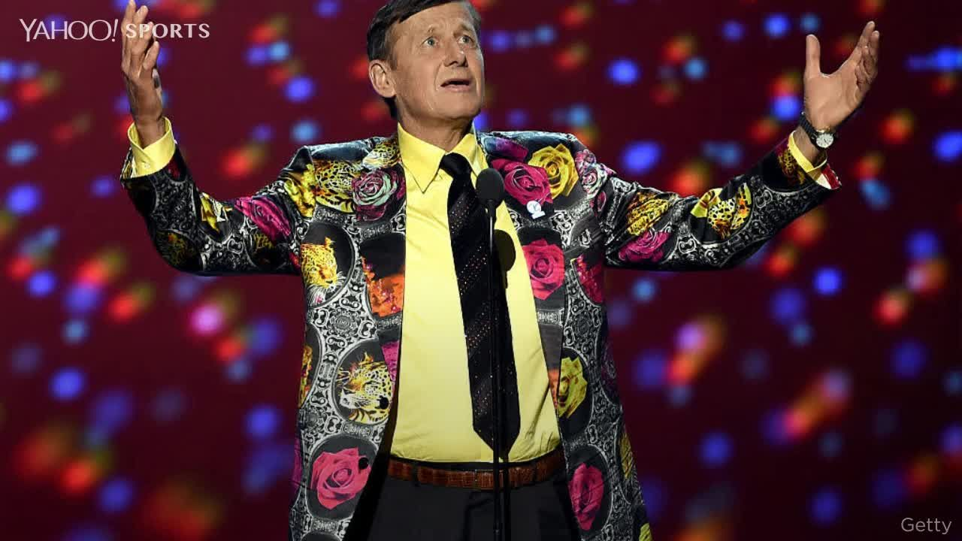
Vocabulary
GARISH- flashy, tastelessly loud and brightly colored
INSTIGATE - to stir up

Slide 18
Week 3: Thursday, 9/14
Grammar Rule/Part of Speech:
Adverbs: modify a verb, an adjective, or another adverb. They tell how, when, where, and to what extent.
Example (do not copy): The bird was loudly chirping outside today.

Slide 19
Sentence Corrections
Copy the following sentence and underline the adverbs.
She quietly studied the prodigious size of the blue whale while estatically watching its tricks at the local zoo.

Slide 20
Vocabulary
PRODIGIOUS- enormous; extraordinary
TRIVIAL- insignificant, unimportant

