Slide 1
Week 1: August 28 – September 1
Hickman, English II

Slide 2
School Policies
WELCOME BACK WHIRLIES!

Slide 3
Day 1: Attendance & Tardies
Attendance in class and being on time are important to being a successful student and becoming a responsible adult.
The attendance office is located in the main hall. Ms. Peterson & Ms. Spencer work in the attendance office.
You will need to see them when you are absent, come to school late or need to leave early.

Slide 4
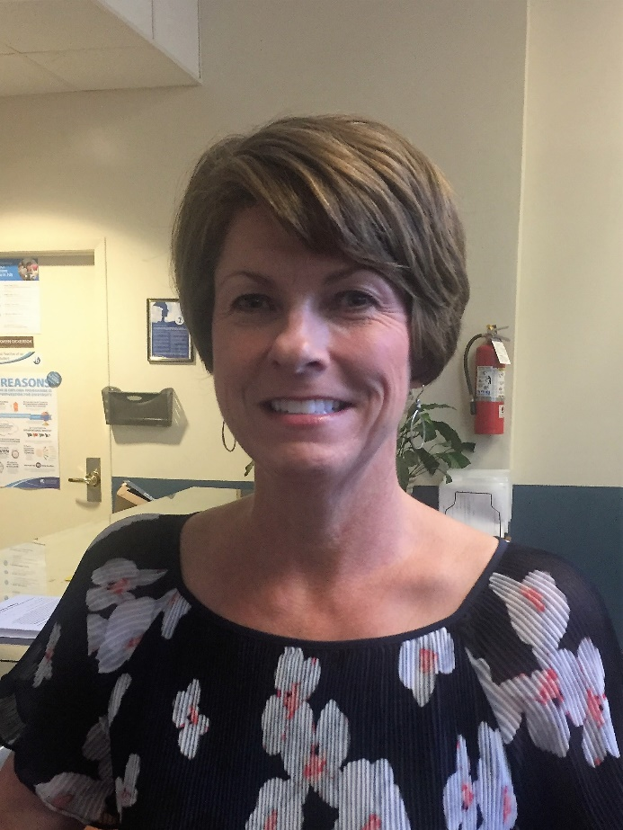
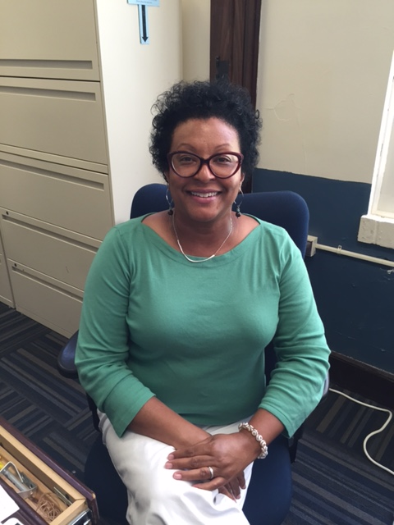
Attendance Office Staff
Ms. Peterson
Ms. Spencer

Slide 5
Attendance Policy & Procedures
If you arrive to school 10 minutes after first period starts you must check-in through the office.
If you must leave school early, bring your note to the attendance office in the morning.
If you have been absent you will have THREE school days to bring a note. It must be dated, contain a lawful reason and be signed by your parent/guardian.
After three days the absence will be marked as UNEXCUSED.

Slide 6
Attendance Policy
During a grading quarter any student who has 4 or more unexcused absences in a class will receive no higher than a 59/F in that course.
Parents may request a waiver from the administration AFTER report cards go out to receive the earned grade if it is higher than a 59/F.
Make attendance a priority, and always bring a note from your parent or guardian within three school days.

Slide 7
Tardy Policy
Teachers will provide one warning.
Teachers will contact parents and give consequences the next two times.
On the fourth tardy the student will be referred to the administration.
A student who is more than 10 minutes late will be considered as skipping.
You have 6 minutes – be on time!

Slide 8
Day 1: Electronics
Phones, mp3 players and tablets are part of our culture but must be used responsibly.
Students can use these devices on campus before school, after school, during lunch and class change or as directed by their teacher.
Students may only charge devices at the charging bar in the cafeteria during lunch, but devices should never be left unattended.

Slide 9
Electronics
From the GCS student handbook:
a) Inappropriate Use of Electronic Devices – Students may not use Electronic Devices, examples of which include but are not limited to cellular phones, laptops, school computers and iPods, in any way that either compromises educational integrity, disrupts the educational environment, or any other lewd, inappropriate or otherwise disruptive manner.

Slide 10
Consequence from the GCS handbook:
Inappropriate use of school electronic devices may result in loss of privileges to use the equipment. Confiscation of the Portable Electronic Device for up to 10 school days with the device to be returned only to an authorized parent or guardian or to the student in the event the child is 18 years of age or older. Repeated or serious violations may result in ISS up to 3 days OSS.

Slide 11
Monday, 08/28
Hickman, English II

Slide 12
Welcome Back
Find your name on a desk, it will be beside the number that corresponds to your period.
You will need a pencil or pen. There are schedules on your desk.
Put phones away in your book bag on silent! They should not be on your desk or in your lap.
You must be seated when the bell rings with a pencil sharpened and ready to go!

Slide 13
You have a lot of papers. Let’s look through them.
You will usually have papers on your desk as you enter the classroom.
1st ONLY - Parent consent forms, lunch forms, Grimsley Goods, and military consent forms come back to me.
All Classes - Should have a syllabus and an information sheet.

Slide 14
Mr. Dodge Intro

Slide 15
Independent Reading
As Mr. Dodge and I circulate, you are to independently (and silently) complete the information sheet and the syllabus reading questions on the back.
We will be discussing this material shortly.

Slide 16
Syllabus Information, Website, Remind, and Receipt of Syllabus
https://magic.piktochart.com/output/15456272-new-piktochart
http://hickmak.weebly.com/

Slide 17
Homework
Complete with parents/guardians the Receipt of Syllabus and Major Text Approval sheet; due by Friday.
Honors Only – Sept. 15 Summer Reading due; tutoring on Wednesdays, so come see me if you have questions
Sign up for Remind 101 and visit my website

Slide 18
Remind Codes 2017-2018
Hickman, English II

Slide 19
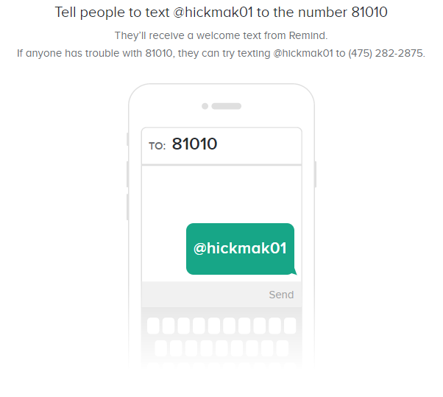
First Period

Slide 20
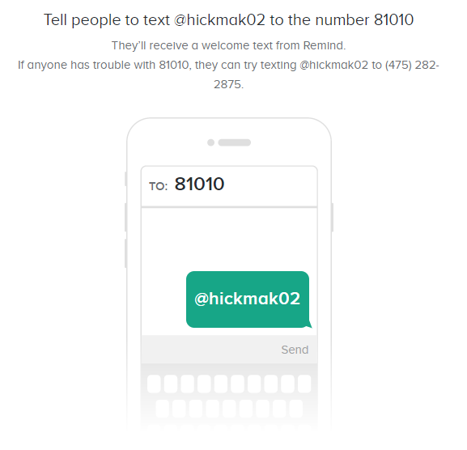
Second Period

Slide 21
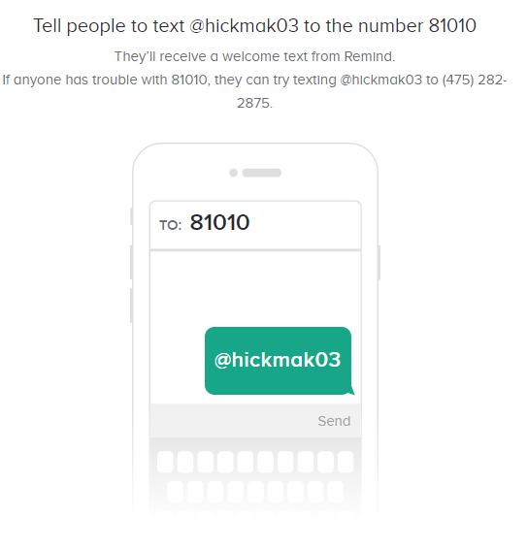
Third Period

Slide 22
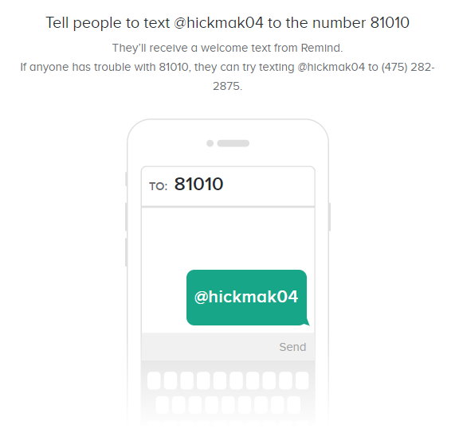
Fourth Period

Slide 23

Sixth Period

Slide 24
Tuesday, 08/29
Hickman, English II

Slide 25

Welcome
Have a seat, have a pencil ready, and PUT PHONES AWAY.
If you have your Receipt of Syllabus, place it on your desk. Do not put it in the tray.
You will receive a warm up sheet, vocab list, and the notes for today.
1st- If you have any forms (military, free/reduced lunch, etc., have those on your desk.
You must be seated when the bell rings ready to go!

Slide 26
Bathroom Passes
You have three passes each quarter, no more.
If you lose your pass, you do not get another one!
Extra credit is 3 points per pass on a test/project.

Slide 27
Week 1:
Tuesday,8/29
Grammar Rule/Part of Speech: Nouns name a person, a place, a thing, or an idea.
Example: (do not copy) As a young woman, Elizabeth Cady Stanton studied mathematics and the classics both at home and at Troy Female Seminary.

Slide 28
Sentence Correction:
Copy the following sentence and underline the nouns:
The acclamation the teacher made was because of all the good grades her students made on their projects.

Slide 29


Vocabulary:
ACCLAIM- to praise
BENEVOLENT- inclined to perform kind acts

Slide 30
Hw
Receipt of Syllabus due by Friday
Meet in computer lab tomorrow. Bring your turnitin worksheet.
Summer Reading Log due on Tuesday for a participation 100. Summer Reading Assignment (Honors) due Sept. 15

Slide 31
School Policies
WELCOME BACK WHIRLIES!

Slide 32
Day 2: Dress Code
Grimsley is not a SMOD school, but we do have a dress code.
Students must dress appropriately for a school environment.
First period teachers will send students who are in violation of the dress code to SI to call for appropriate clothing. Repeat offenders will face disciplinary action.
If you think your outfit is questionable, choose something else.

Slide 33
Dress Code
Students must wear shoes at all times. Bedroom slippers are not considered shoes.
Shorts and skirts will not be shorter than mid-thigh. Splits in skirts should be no higher than mid-thigh.
If leggings are worn under a skirt, the length of the skirt must still be mid-thigh.
If leggings are worn as pants, they must be covered by tops that are mid-thigh in length.
No pants may have holes cut into them above mid-thigh.

Slide 34
Dress Code – con’t
Halters, tube tops, racer-back tops, or see-through clothing are not permitted. The necklines of shirts and blouses must not expose the chest area.
Sleeveless tops and tank tops must have straps that are at least two (2) inches in width.
T-shirts with sleeves must be worn under tank tops that expose the chest area.
Clothing must not be excessively tight.
Clothing must be worn so that it does not expose underwear. Pajamas and pajama pants are not acceptable for school and must not be worn.

Slide 35
Dress Code – con’t
Sun glasses and headgear may not be worn in the building.
Students may not possess or display bandanas on Grimsley property (including buses) or at any GHS function.
Jewelry or accessories that could be used as a harmful object may not be worn.
Clothing, jewelry, or accessories depicting alcoholic beverages, weapons, controlled substances, Confederate flags, or anything obscene or offensive in nature will not be worn.

Slide 36
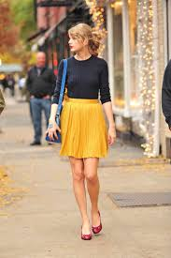
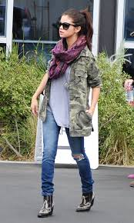
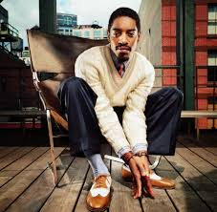
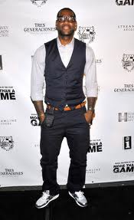
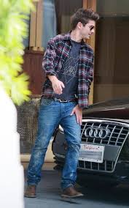
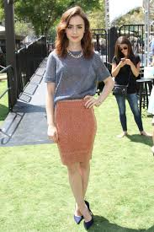
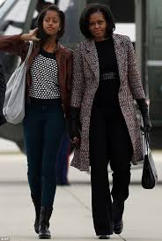
Look good whirlies….

Slide 37
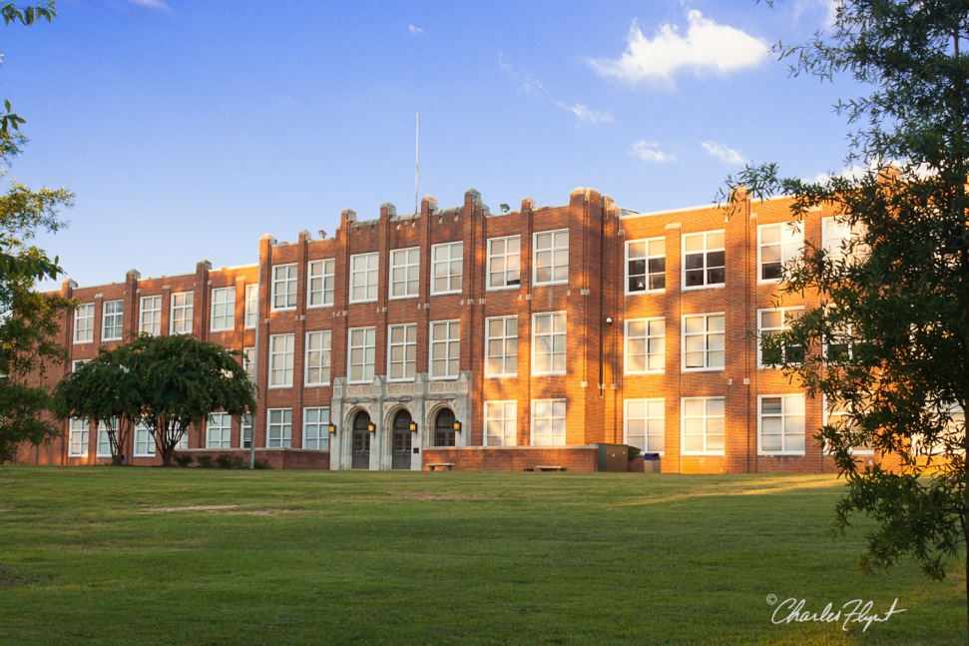
Day 2: Meet your team
Grimsley faculty and staff are here to help!
Get to know your administrators, counselors, teachers and other support staff.
Connect with fellow students through clubs and sports.

Slide 38
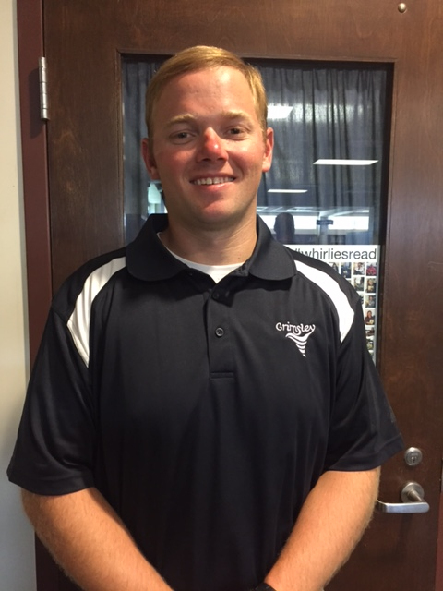
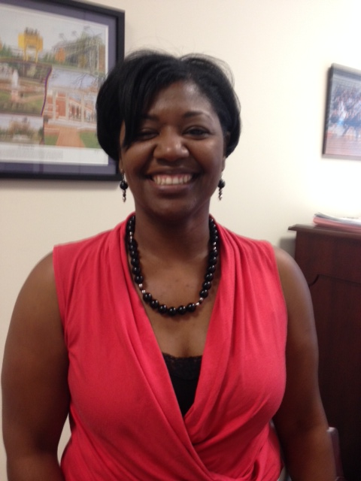
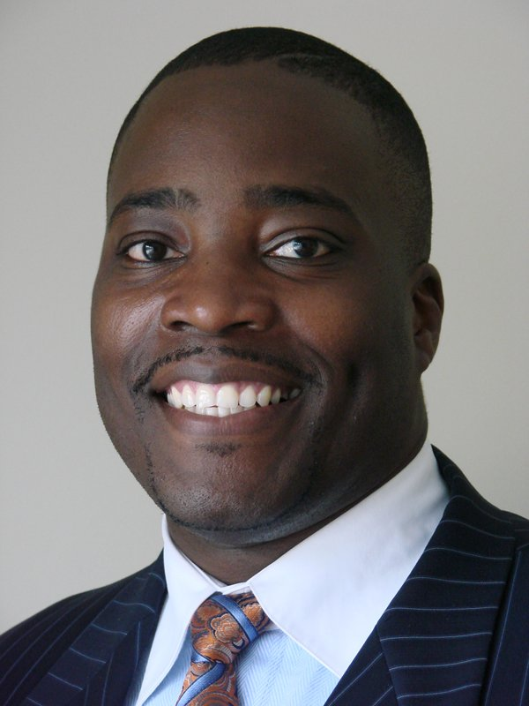
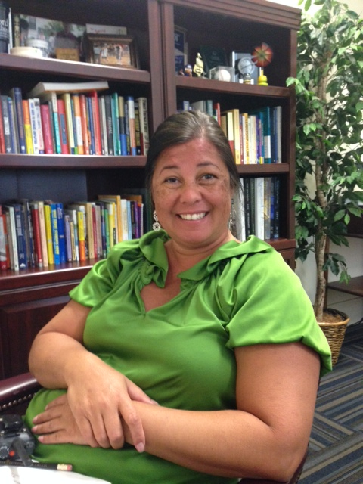
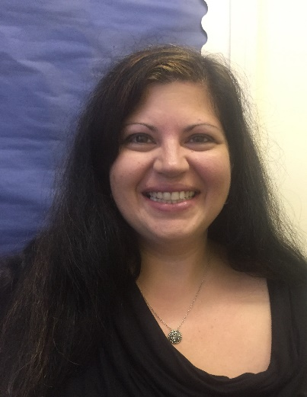
Grimsley Administration
Mr. Moody:
students A - D
Ms. Bailey:
students K-Q
Principal
Dr. Miller
Ms. Hill:
students E - J
Ms. Ertzberger: students Rh - Z

Slide 39
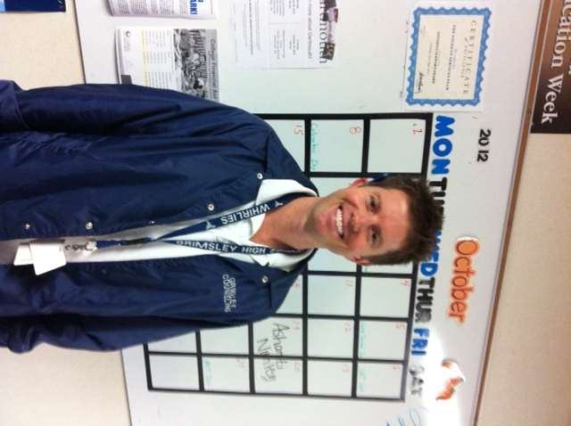
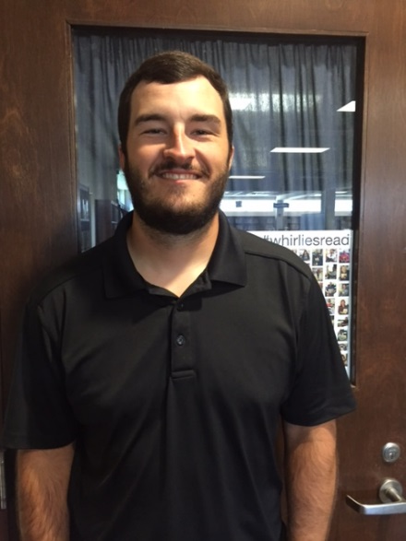
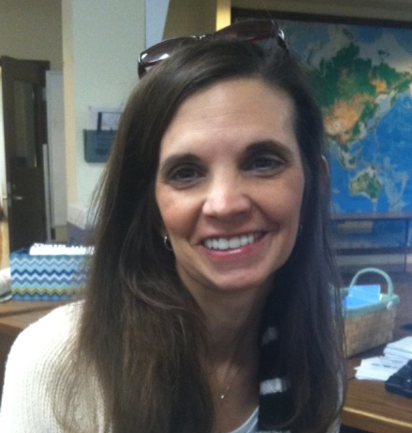
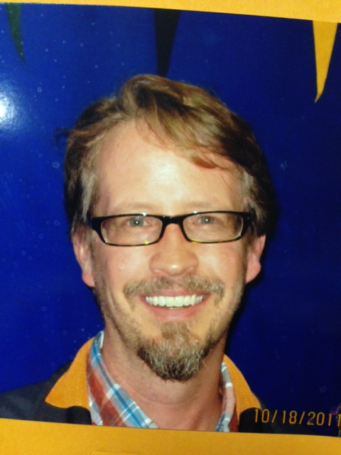
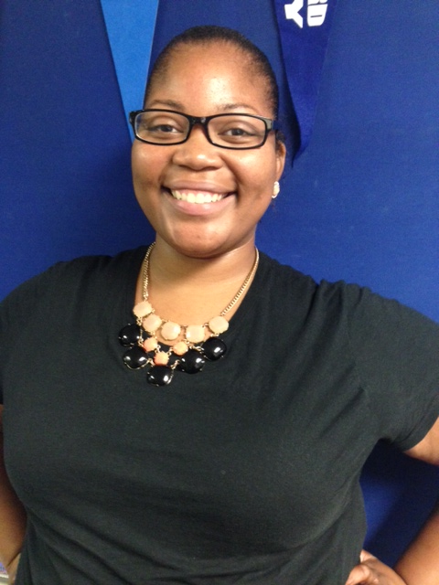
Grimsley Counselors
Mr. Brown
Students A - D
Mr. Lauer
Students E - J
Ms. Marsh
Students K - Q
Mr. Harrington Students R - Z
Ms. Pearson
IB students

Slide 40
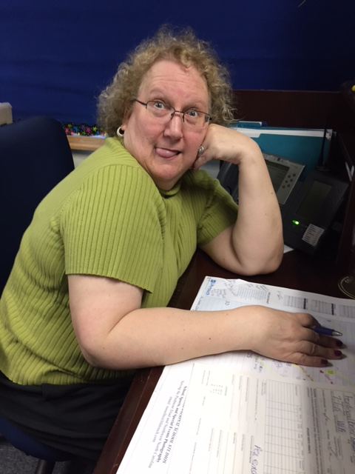
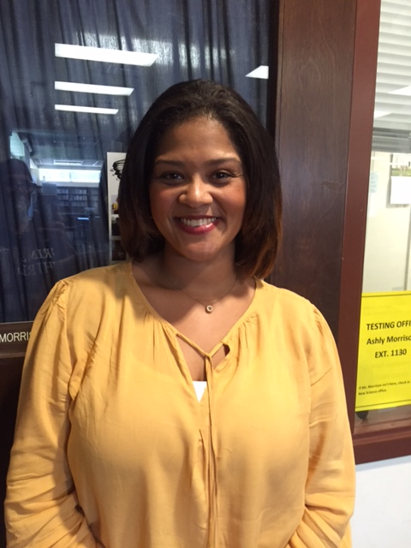
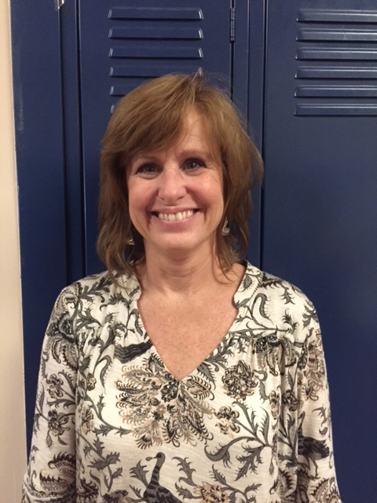
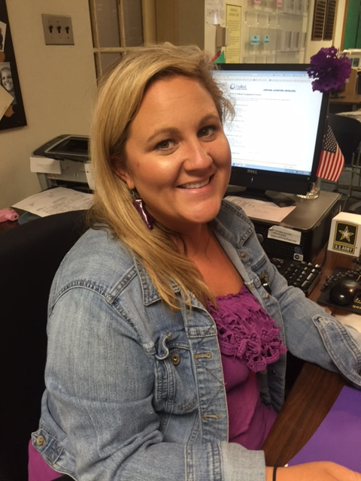
Grimsley Office Staff
Ms. Underwood
Registrar - Counseling
Ms. Bowe
Main Office
Ms. Ericksen
Treasurer
Ms. Anderson
Counseling

Slide 41
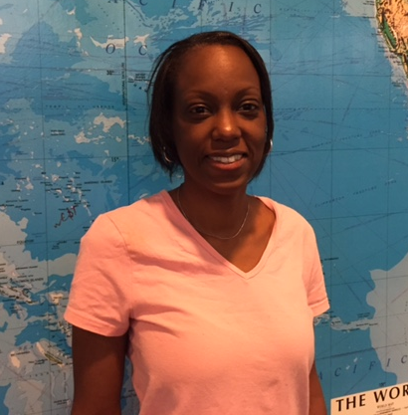
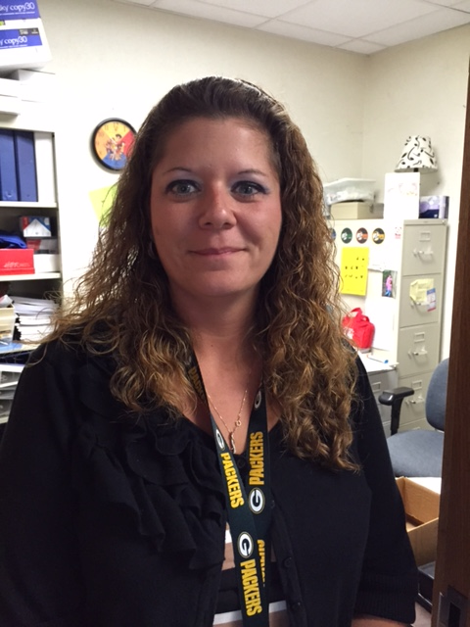
Ms. Welch
School Nurse
Ms. Southerland
Social Worker
Visit them in the counseling office.

Slide 42


GRIMSLEY GOODS
provides free and confidential assistance with food and clothing needs for all Whirlie families!
Visit the counseling center for sign-up details!

Slide 43
Go Over Plagiarism Powerpoint
Go over Turnitin

Slide 44
Turnitin Codes
Standard:
2nd - Class ID: 10089277 password: Hickman2
4th - Class ID: 10089298 password: Hickman4
Honors:
1st - Class ID: 10089248 password: Hickman1
3rd- Class ID: 10089291 password: Hickman3
6th- Class ID: 10089309 password: Hickman6

Slide 45
Wednesday, 08/30
Hickman, English II

Slide 46
Day 3: Discipline
Grimsley students expect and demonstrate excellence every day, academically, how we behave and how we treat each other.
Grimsley students must respect the learning environment of their fellow students.

Slide 47
Classroom Disruptions
Students are not allowed to disrupt instruction of the classroom teacher or the learning of other students. Teachers will attempt to correct misbehavior with a warning and classroom consequences. If the student does not respond to the intervention, the teacher may send the student to Student Intervention (SI). Serious classroom disruptions may be directly referred to administration.

Slide 48
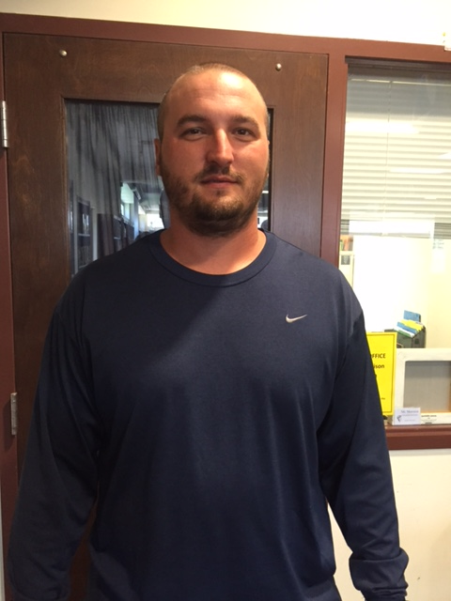
Student Intervention
SI is located in room 100 on the first floor of the main building.
Mr. Rigsbee is the SI coordinator.
Repeated referrals to SI will result in discipline action by the administrator.
Coach Rigsbee

Slide 49
Consequences for Rule Violations
1st Offense | Time served and parent contact by the classroom teacher.
2nd Offense | Time served and parent contact by the classroom teacher.
3rd Offense | ISS/SI Coordinator gives the referral to the administrator. One day ISS assigned by the administrator. Parent contact by teacher and administrator.
4th Offense and beyond | ISS/SI Coordinator gives the referral to the administrator. Two days ISS up to OSS assigned by the administrator. Parent contact by teacher and administrator.

Slide 50
From the student handbook…
Rule 6: Noncompliance with Directives from Principals, Teachers and Other School Personnel
Students shall comply with the directions of all school personnel.
Rule 14. Fighting Among Students
Students shall not fight or attempt to cause bodily harm to another student through physical contact. If a student is attempting to involve another student in a fight, the other student should walk away and report it to a teacher, assistant principal or principal.
Rule 8: Insulting, Abusive, Harassing, Profane, Obscene or Seriously Disrespectful Words, Acts of Touching, Gestures, Signs, Verbal Threats, Acts of Bullying or Intimidation, or Other Acts
Students shall respect other students, visitors, school employees and other persons by utilizing appropriate language and behaviors at all times.

Slide 51
Additional Issues
Open Lunch
Seniors are the only students allowed to leave campus during lunch. Underclassmen are not allowed to go to the parking area or leave campus. Underclassmen caught leaving campus and seniors giving underclassmen a ride off campus during lunch are subject to disciplinary actions including loss of open lunch privileges for seniors.
*Seniors should not return to campus with food deliveries for underclassmen.
Parking Lot
Students are not allowed in the parking lot during class or class changes. Students are to leave their cars within five (5) minutes of arriving on campus.

Slide 52
Restricted Areas of Campus
Upon arrival at school, students are to remain on campus until the official dismissal. Students are not allowed to loiter in the parking lots or to return to their vehicles during the school day. Buildings are not open until 8:45 a.m. unless a student is attending a zero period class. All wooded areas surrounding the campus are restricted. Restricted areas include: all wooded areas surrounding the campus, the back of the New Science building, the south end of the Old Science building, all areas south of the New Science building, and other areas designated at administration’s discretion. All athletic facilities are off limits during the school day unless accompanied by a Grimsley staff member or administrator.
Loitering
Students are not to loiter in surrounding neighborhoods, on street corners, or in the parking lot. Students are to report directly to the school grounds upon returning from Weaver Center, and for seniors immediately following lunch. Students are not allowed to remain on campus after 4:10 pm unless they are involved in tutorials or an extra-curricular activity that is supervised by an authorized adult.

Slide 53
Prohibited Items
The following items should not be brought to campus by students. Students who choose to bring these items to school may face disciplinary action.
Incendiary devices (lighters, matches, etc.), playing cards, e-cigarette devices, dice, and any item specifically mentioned as prohibited in the GCS Student Handbook.

Slide 54
Welcome
Have a seat, have a pencil ready, and PUT PHONES AWAY.
If you have your Receipt of Syllabus, place it on your desk. Do not put it in the tray.
You must be seated when the bell rings ready to go!

Slide 55
Week 1:
Wednesday, 8/30
Grammar Rule/Part of Speech:
Common nouns: names any one of a group of persons, places, things, or ideas.
Proper noun: names a particular person, place, thing, or idea.
Example: (do not copy) In 1840, Elizabeth Cady (proper) married Henry Stanton (proper), a prominent abolitionist (common).

Slide 56
Sentence Correction
Copy the following sentences and underline the nouns (identify as common or proper):
The student teacher, Ms. Kaneshiro, divulged the secret. They were going on a field trip to the Grand Canyon.

Slide 57

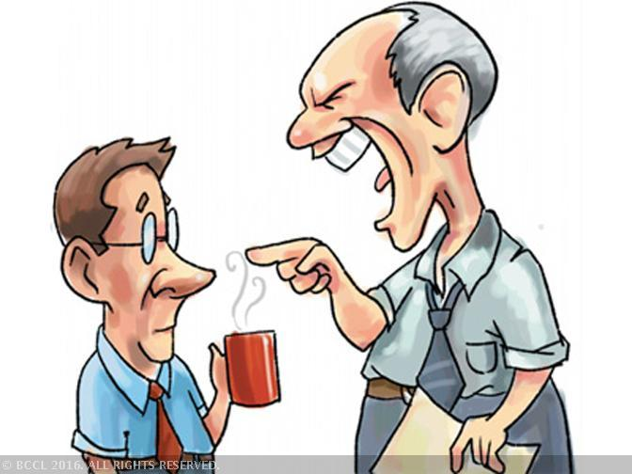
Vocabulary
CONDESCEND- to deal with people in a superior manner
DIVULGE- to make known, reveal

Slide 58
Thursday, 08/31
Hickman, English II

Slide 59
Day 4: Grimsley Honor Code
Recognizing the importance of each student as an individual, I will accept as my responsibility to demonstrate the components of both academic and personal integrity, including respect, honesty, kindness, work ethic and civility.
Accepting my position as a significant member of this student body, I will conduct myself in a manner that exemplifies pride in myself and my school.
Seeing the necessity to lead, as well as to follow, I will challenge my peers to create an environment that is conducive to learning, accepts everyone, and allows them to reach their full potential.

Slide 60
Academic Integrity
Our honor code includes building academic integrity in each student.
Is this cheating?
Copying
Sharing questions or answers on tests or quizzes
Presenting another’s work as your own
YES! Your integrity is not worth the grade.

Slide 61
Building Character
Responsibility
Respect
Kindness
Courage
Integrity
Self-Discipline
Perseverance
Whether in class or on the field, in the halls or online, at school or at home; Grimsley Whirlies will strive to exhibit these qualities.

Slide 62
Service-Learning
Service-Learning is a way to connect positive and meaningful action in the community with academic learning, personal growth and civic responsibility. Service-Learning helps develop citizenship and good character while providing
direct connections to the academic curriculum.

Slide 63
Recognition
Service-Learning Diploma
250 documented hours during high school
S-L Exemplary Award
100 documented hours during high school
Questions?
See Mr. Lauer (counseling) for more information.
Look for more information about the Grimsley Service-Learning Club – bulletin board across from counseling.

Slide 64
Diploma Endorsements
In addition to Service-learning, students can earn several endorsements on their NC High School Diploma & transcript.
  Career
  College
  College/UNC
  NC Academic Scholar
  Global Language
See your counselor about specific requirements.

Slide 65
Welcome
Have a seat, have a pencil ready, and PUT PHONES AWAY.
If you have your Receipt of Syllabus, place it on your desk. Do not put it in the tray.
You will receive a poem and a worksheet today
You must be seated when the bell rings ready to go!

Slide 66
Week 1:
Thursday, 8/31
Grammar Rule/Part of Speech:
Compound Nouns: consists of two or more words that together name a person, place, thing, or an idea
  Example (do not copy): I enjoy playing basketball with my brother and sister-in-law.
Collective Nouns: names a group of people, animals, or things.
  Example (do not copy): The audience enjoyed watching the orchestra perform.

Slide 67
Sentence Correction:
Copy the following sentence and underline the collective and/or compound nouns:
The insipid newspaper focused its attention on the stock market. Noone but the staff at a large bank cared about the boring article.

Slide 68

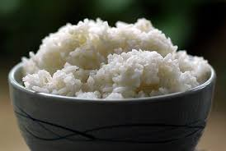
Vocabulary
FRIVOLOUS- unworthy of serious attention
INSIPID- lacking flavor or zest; dull

Slide 69
Friday, 09/01
Hickman, English II

Slide 70

Day 5: Planning for the Future
Now is the time to prepare for your life after high school.
Your high school diploma is only the first step!
Where do you want to be in five years?

Slide 71
Make the grade
Take the courses you need to graduate and pursue your goals.
Do your best and seek help when you need it.
Explore possible career options while in high school.
Prepare for your exams, they count – all final exams will count 20% of your final grade.
Counselors, teachers, administrators, coaches – all adults at Grimsley are here so that you can reach your goals.

Slide 72
Grading Scale
All students will be graded on a 10-point grading scale:
A: 90-100
B: 80-89
C: 70-79
D: 60-69
F: 59 or lower
Students who started ninth grade this year or last year will earn quality points (GPA) on a new scale:
Standard class A = 4.0
Honors class A = 4.5
AP/IB A = 5.0

Slide 73
After School
When the school day ends, students should move to their cars or buses quickly, unless they are participating in supervised after school activities.
Teachers have tutorials at least one day after school.
The Media Center is open until 5:00pm on Mondays & Wednesdays.
Grimsley Perk (peer tutorial) will start when late buses start.
Late buses will start running Mon – Thurs. in a few weeks.

Slide 74
Testing dates
PSAT is on October 11 for Juniors and Sophomores
PreACT is in Oct/ Nov for Sophomores
Workkeys is in February for CTE completers
ACT is on Feb 27 for Juniors
AP/IB exams are in May
EOCs, NCFEs and teacher final exams are in May & June
*Freshmen who want to take the PSAT, should see Ms. Morrison in Media Center. ($15)
Students who need to take the SAT should register online or see your counselor.

Slide 75
Welcome
Have a seat, have a pencil ready, and PUT PHONES AWAY.
If you have your Receipt of Syllabus, place it on your desk. Do not put it in the tray.
Clear desk except Warm-ups and Syllabus sheet and a pencil
You must be seated when the bell rings ready to go!

Slide 76
Week 1:
Friday, 9/1
Grammar Rule/Part of Speech: a pronoun takes the place of one or more nouns or pronouns.
Example: Susan watched the monkey make faces at her little brother and sister. She laughed at it more than they did.

Slide 77
Sentence Correction:
Copy the following sentences and underline the pronouns.
Mr. Rogers had a predilection for learning . He stressed this to his viewers, and hoped that they shared the same enthusiasm.

Slide 78


Vocabulary
PREDILECTION- a preference; a tendency toward favoring
TREACHERY- deliberate betrayal of trust

