Slide 1
Week 19 PPT
Hickman, English II

Slide 2
Monday

Slide 3
Monday Grammar Pattern
Use a singular pronoun to refer to any of the following antecedents: anybody, anyone, anything, each, either, everybody, everyone, everything, neither, nobody, no one, nothing, one, somebody, someone, or something.
Example: Someone left a pair of shoes on the boys’ locker room floor, and he had better pick them up before the coach sees them.

Slide 4
Sentence Correction
Copy the following sentence, underline the pronoun and antecedent, and correct if necessary.
According to the judge, everyone knows that if they are complicit, they could end up serving jail time.

Slide 5
Tuesday

Slide 6
Tuesday Grammar Pattern
Use a plural pronoun to refer to any of the following indefinite pronouns: both, few, many, or several.
Example: The judge met with both of the attorneys and their clients.

Slide 7
Sentence Correction
Copy the following sentence, underline the pronoun and antecedent, and correct if necessary.
The dissent between several of the seniors caused him to serve detention in order to be able to graduate.

Slide 8
Wednesday

Slide 9
Wednesday Grammar Pattern
Use a plural pronoun to refer to two or more antecedents joined by and. Use a singular pronoun to refer to two or more singular antecedents joined by or or nor.
Example: Either Paul or Diego is willing to drive his car to the retreat in September.

Slide 10
Sentence Correection
Copy the following sentence, underline the pronoun and antecedent, and correct if necessary.
Both Apple and Microsoft are known for her innovative products.

Slide 11
Thursday - Correct the following sentences
Everyone should be in (his/her, their) seat before the curtain goes up.
Neither Tom nor Jim can give (his, their) report today.
All of us is prepared to give (our, their) speech on Thursday.
Several of the students have asked for an extension on (his/her, their) reports.
Jim wants to make sure that (his, its) lawn is the best in the neighborhood.

Slide 12
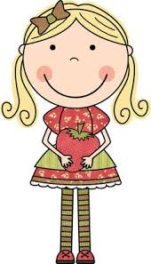
Vocabulary
Banal
Complicity
ordinary and commonplace
participation in a bad act or a crime

Slide 13
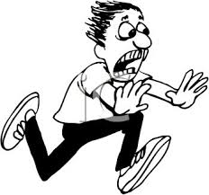
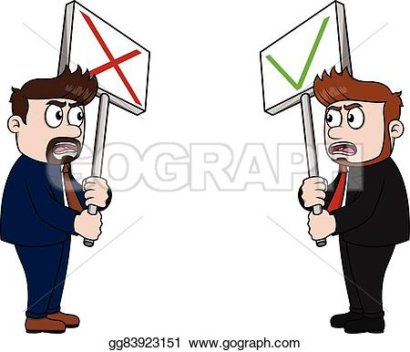
Vocabulary
Dissent
Frenetic
Disagreement
wildly excited; frenzied; frantic

Slide 14
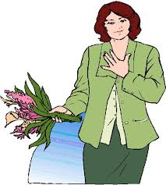
Vocabulary
Innovative
Poignant
new and creative
touching

Slide 15
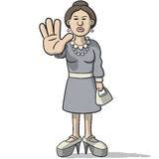
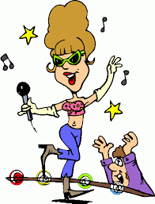
Vocabulary
Thwart
Zealous
to stop or prevent
filled with or motivated by enthusiastic devotion

