Slide 1
Week 16

Slide 2
Monday

Slide 3
Welcome
Put phones away and have something to write with. Fill out your scantron. Date is 12/11
Honors – If you have late source notes, put them in the tray. Keep your outlines. I will need to go over these with everyone.
Standard – Study Guides for extra credit? I need them now.

Slide 4
When finished…..
Standard – Read the accompanying article on your desk and answer the questions that follow.
Honors – Read the exemplar essay and answer the questions. Consider what I did for your rough draft.

Slide 5
Tuesday

Slide 6
Rule 1 Grammar Pattern
Some indefinite pronouns are singular, some are plural, and some can be singular or plural depending on how they are used.
Singular: anybody, anyone, anything, each, either, everybody, everyone, everything, neither, nobody
Plural: both, few, many, and several
Both: all, any, more, most, none, and some.

Slide 7
Sentence Correction
Copy the following sentence, underline the subject and verb, and correct if necessary.
Many of the applicants was competent and qualified for the position, so the employer had a tough decision to make.

Slide 8
Day Two Grammar Pattern
Compound subjects joined by and usually take a plural verb. Singular subjects joined by or or nor take a singular verb. When a singular and plural subject are joined by or or nor, the verb agrees with the subject nearer the verb.
Example: Either the musicians or the singer is off key.

Slide 9
Sentence Correction
Copy the following sentence, underline the subject and verb, and correct if necessary.
Neither the principal nor the teachers has answers for the discrepancy in the reports.

Slide 10
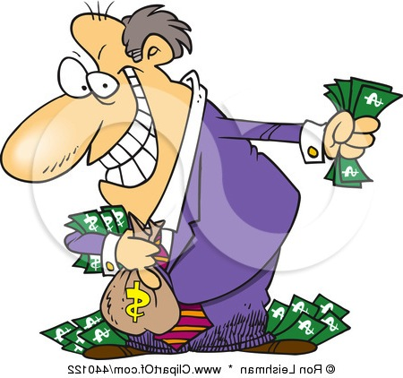
Vocabulary
Avarice
Competent
greed
having adequate ability

Slide 11
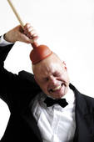
Vocabulary
Discrepancy
Fatuous
an unexpected difference
foolish, ridiculously stupid

Slide 12
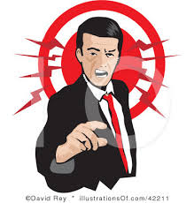
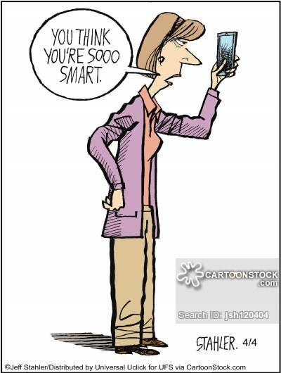
Vocabulary
Indignation
Patronize
anger (over something unjust)
to treat condescendingly

Slide 13
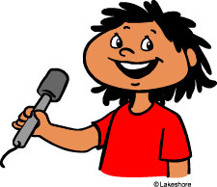
Vocabulary
Tact
Warrant
sensitivity in dealing with others
to justify

Slide 14
Wednesday

Slide 15
Day 3 Grammar Pattern
Use don’t with all plural subjects and with the pronouns I and you. Use doesn’t with all singular subjects except the pronouns I and you.
Example: He doesn’t live here anymore.

Slide 16
Sentence Correction
Copy the following sentence, underline the subject and verb, and correct if necessary.
The crooked lawyer don’t have any indignation for convicting an innocent man.

Slide 17
1 – 8 Match the Scenarios

Slide 18
1

Slide 19
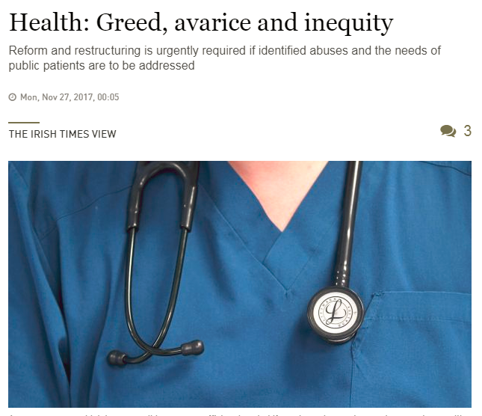
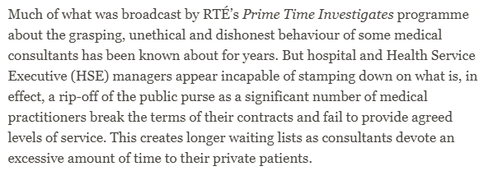
2

Slide 20
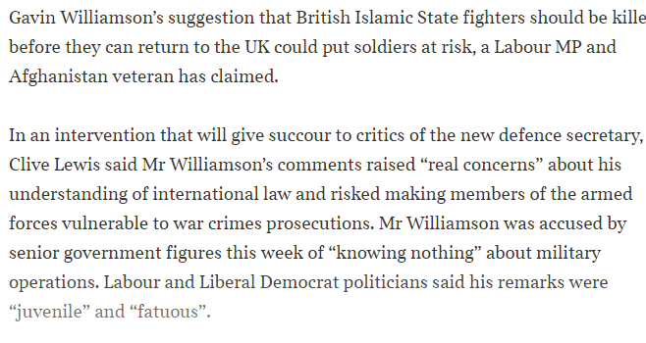
3

Slide 21
4

Slide 22
5

Slide 23
6

Slide 24
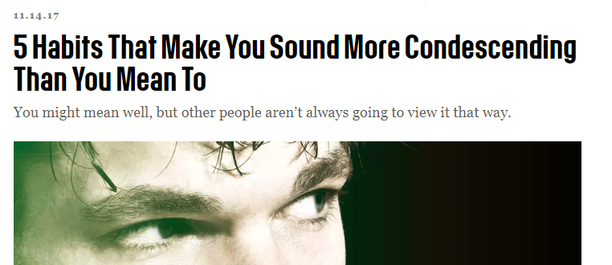
7

Slide 25
8

Slide 26
Thursday

Slide 27
Day 4 Grammar Pattern
When the subject follows the verb, find the subject and make sure that the verb agrees with it.
Example: Here are the books you reserved.

Slide 28
Sentence Correction
Copy the following sentence, underline the subject and verb, and correct if necessary.
There were a child left at the school after hours; his parents had no tact when expressing their anger to the principal.

