Slide 1
Week 15

Slide 2
Monday

Slide 3
Welcome Back
Make sure you have a pencil ready. Phones should be off desks and out of laps. Headphones out!
Put your name on the warm up sheet. The week is Monday, 12/04 to Friday, 12/08.
Honors: Take out the work for, “Letter from Birmingham.”
I will come by and grab your minibook.
Standard: If you have the Argument Introduction Article, take it out.
Tutoring Wednesday of this week only.

Slide 4
Week 15 – Day 1 Grammar Pattern
Use ellipsis points to mark omissions from quoted material and pauses in a written passage. When you omit words from the middle of a sentence, use three spaced ellipsis points.
Example: In his autobiography, Galarza recalls, “It was easy for me to feel that becoming a proud American…did not mean feeling ashamed of being a Mexican.”

Slide 5
Sentence Correction
Rewrite the following passages, omitting the italicized parts and using ellipsis points to punctuate each omission correctly.
The team was described as being a cohesive unit known for their great team work, ability to motivate others, and rapport with students.

Slide 6
Sort Directions
Work in your small groups and sort the items. Figure out the categories. Talk to each other!!!!
Record your words and definitions on the backside of your warm up.

Slide 7
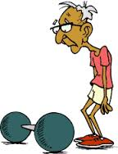
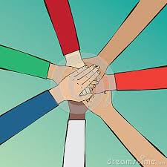
Vocabulary
Atrophy
Cohesive
to waste away
sticking or holding together

Slide 8
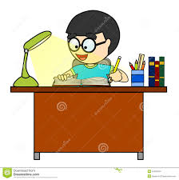
Vocabulary
Diligent
Exalt
hard working
to elevate, glorify, or praise

Slide 9
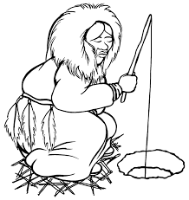
Vocabulary
Indigenous
Paradox
native
a seemingly contradictory statement that may nonetheless be true

Slide 10
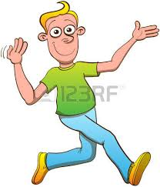
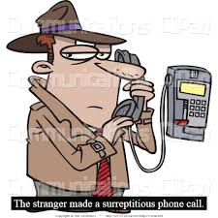
Vocabulary
Surreptitious
Vivacious
done or made by secret or stealthy means
lively

Slide 11
HW SLIDE
Rhetorical Triangle Graphic Organizer due tomorrow.
Source 1 Analysis due Thursday at the start of class
We will be working on your outline in class on Wednesday. This would be a great time to bring all your sources and work since the outline is due Friday. However, if you are not prepared, there will be an alternative outline assignment. All students will receive a grade for their work that day regardless of your own outline or the alternate outline assignment. That will give you Thursday and Friday instead to work on the source sheets due to me and your rough draft due 12/12.

Slide 12
Absent Friday, MiniBook due Wednesday
Unless you were absent, the mini-book is due at the end of class. There can be discussion, but no copying.
I just need the mini-book. You keep the speech for future reference on your upcoming test, 12/11.
1st – Ben and Jordan R.
3rd – Jack G. and Roman
6th – Anna

Slide 13
Tuesday

Slide 14
Warm Up Directions
On the back with the vocabulary portion, complete the far right side regarding synonyms, antonyms, and other questions that are word specific.
Be prepared to share your thoughts/answers.

Slide 15
Day 2 Grammar Pattern
Use a hyphen to separate compound adjectives when they precede the word they modify.
Example: Well-liked author vs an author who is well liked.

Slide 16
Sentence Correction
Copy and correct the following sentence.
The world renowned composer was exalted for his long career of musical excellence.

Slide 17
Wednesday

Slide 18
Vocabulary Warm Up Directions
Number the words A – H on your sheet with Astute being A and Vigilant being H
In this box that asks for you to find a picture, number 1 – 8 vertically.
We are going to match items to the vocab words. For each item, 1 – 8, choose which word best fits in the context. Record your answer in the box.

Slide 19
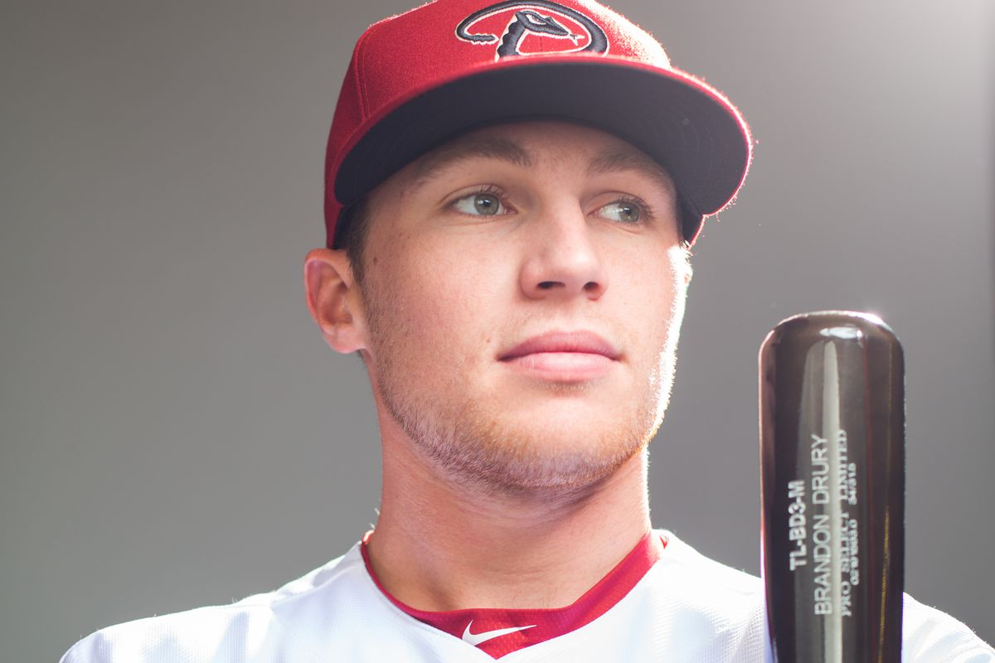
1

Slide 20
2

Slide 21
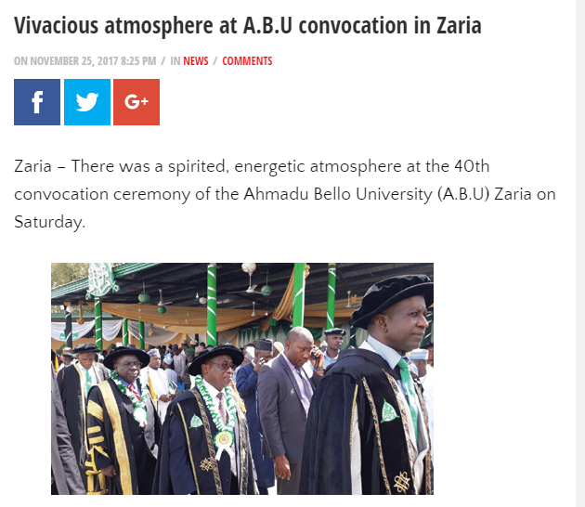
3

Slide 22
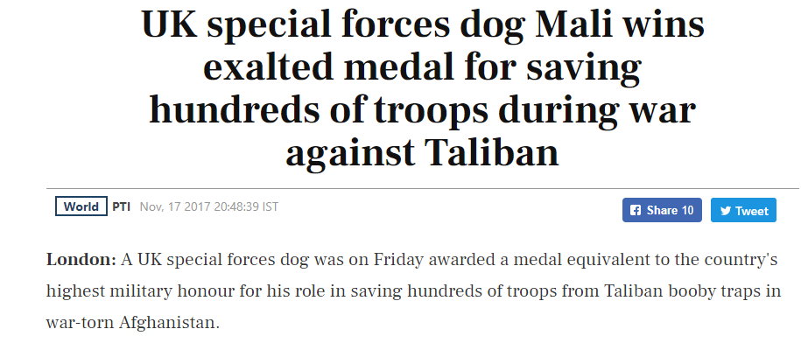
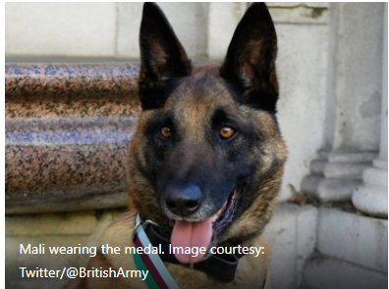
4

Slide 23
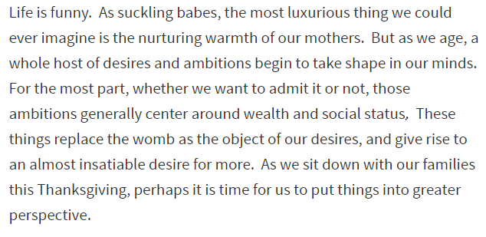
5

Slide 24
6

Slide 25
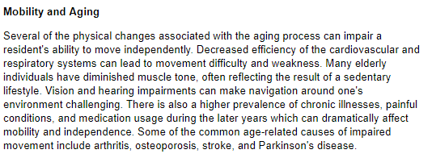
7

Slide 26
8

Slide 27
Day 3 Grammar Pattern
A verb should agree in number with its subject. Singular subjects take singular verbs and plural subjects take plural verbs.
Example: He illustrates books for young readers.
They illustrate books for young readers.

Slide 28
Sentence Correction
Copy the following sentence, underline the subject and verb, and correct if necessary.
The indigenous natives of the country was displaced from their homes.

Slide 29
Thursday

Slide 30
Welcome Back
Make sure you have a pencil ready. Phones should be off desks and out of laps. Headphones out!
You will need your warm up.
Honors:
Standard:

Slide 31
Day 4 Grammar Pattern
The number of a subject is not changed by a word in a phrase or a clause following the subject.
Example: The short stories in this anthology are by various contemporary American Indian writers.

Slide 32
Sentence Correction
Copy the following sentence, underline the subject and verb, and correct if necessary.
The vivacious young girl known for her beautiful eyes were very popular at her school.

Slide 33
Warm Up Directions
Complete the following half sheet as practice for the quiz tomorrow. You will attach this to your warm up sheet tomorrow. You must have both to get full credit.

