Slide 1
Week 14

Slide 2
Welcome Back
Make sure you have a pencil ready. Phones should be off desks and out of laps. Headphones out!
Put your name on the warm up sheet. The week is Monday, 11/27 to Friday, 12/01. It’s a little different and we will talk about it.
Standard: If you have the Argument Introduction Article, take it out.
Tutoring Wednesday of this week only.

Slide 3
Day 1 Grammar Rule
A colon calls to attention what follows. It also separates numbers in parts of scriptural references and titles from subtitles. When a colon appears between two independent clauses, it signals that the second clause will explain or expand on the first.
Example: No one expected the game to end as it did: after seven extra innings, the favored team collapsed.

Slide 4
Day 1 - Sentence Correction
Copy the following sentence and correct if necessary.
Tiresias was known for his clairvoyance. He was able to help both Odysseus and Oedipus understand their futures.

Slide 5
Sort Directions
Work in your small groups and sort the items. Figure out the categories. Talk to each other!!!!
Record your words and definitions on the backside of your warm up.

Slide 6
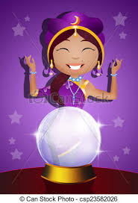
Vocabulary
Astute
Clairvoyance
having sharp judgment
the power to see things that cannot be perceived by the senses

Slide 7
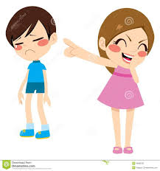
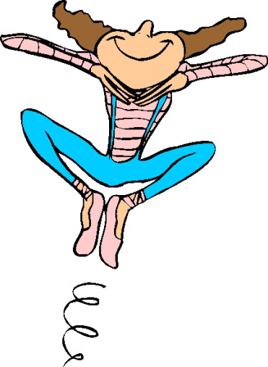
Vocabulary
Deride
Euphoria
to speak of or treat with cruelty
a feeling of great happiness

Slide 8
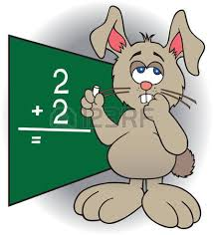
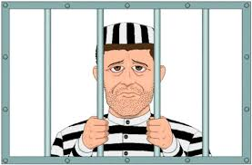
Vocabulary
Incorrigible
Obtuse
incapable of being corrected or reformed
lacking intellect

Slide 9
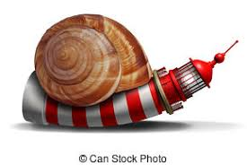
Vocabulary
Vigilant
Stagnant
not moving, flowing, or developing
alert; watchful

Slide 10
Tuesday

Slide 11
Welcome Back
Make sure you have a pencil ready. Phones should be off desks and out of laps. Headphones out!
You will need your warm up.
Honors: Take out your Appeals Work if you did not submit yesterday. It is due now.
Standard: Pull out your Argument Notes from yesterday.
Tutoring Wednesday of this week only.

Slide 12
Warm Up Directions
On the back with the vocabulary portion, complete the far right side regarding synonyms, antonyms, and other questions that are word specific.
Be prepared to share your thoughts/answers.

Slide 13
Day 2- Grammar Pattern
A dash marks a break in thought, sets of a nonessential element for emphasis or clarity, or follows an introductory list or series.
Example: Eager, determined to succeed, and scared to death- all of these describe how I felt on the first day at work.

Slide 14
Day 2 - Sentence Correction
Copy the following sentence and correct if necessary.
I was happy that I had gotten away with my crimes: but the euphoria didn’t last long.

Slide 15
Wednesday

Slide 16
Welcome Back
Make sure you have a pencil ready. Phones should be off desks and out of laps. Headphones out!
You will need your warm up.
Honors: Take out your Advertisement. It is due now.
Standard: Pull out your Articles and Worksheet from yesterday.
Tutoring today only this week.

Slide 17
Vocabulary Warm Up Directions
Number the words A – H on your sheet with Astute being A and Vigilant being H
In this box that asks for you to find a picture, number 1 – 8 vertically.
We are going to match items to the vocab words. For each item, 1 – 8, choose which word best fits in the context. Record your answer in the box.

Slide 18
1
The bully _______________ Tom’s bike: he made fun of the color and size. Tom went home that evening and cried.

Slide 19
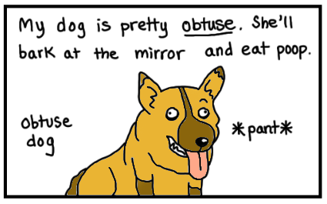
2

Slide 20
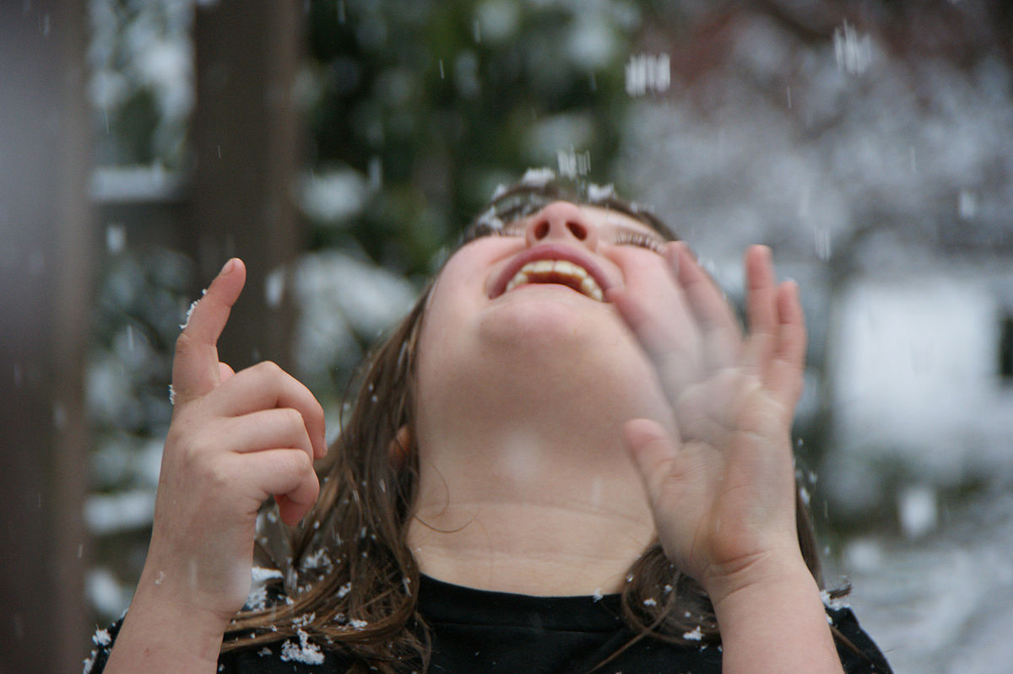
3
Malaria and dengue are among the main dangers of stagnant water, which can become a breeding ground for the mosquitoes that transmit these diseases.^{[2]}
Stagnant water can be dangerous for drinking because it provides a better incubator than running water for many kinds of bacteria and parasites. Stagnant water is often contaminated with human and animal feces, particularly in deserts or other areas of low rain
Health Risks Associated with Stagnant Water (PDF) (Report). Recommendations for Occupational Health and Safety Following Disasters. World Health Organization. 2013.

Slide 21
4

Slide 22
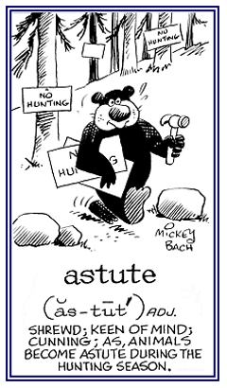
5

Slide 23
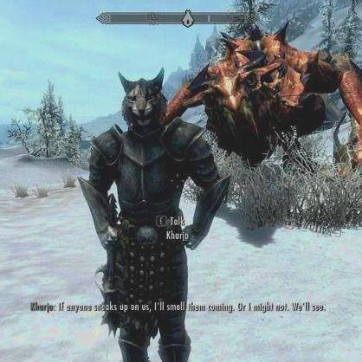
6
What is he lacking?

Slide 24
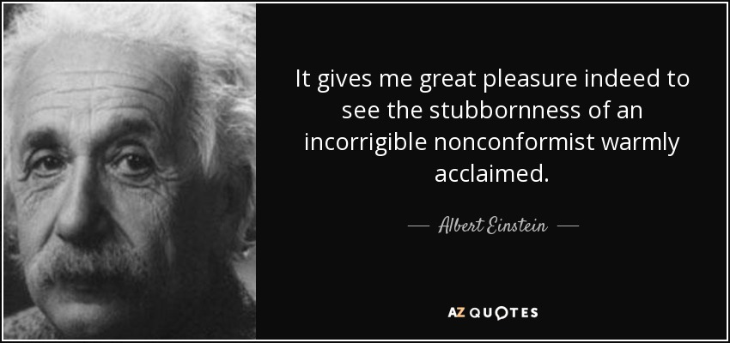
7

Slide 25
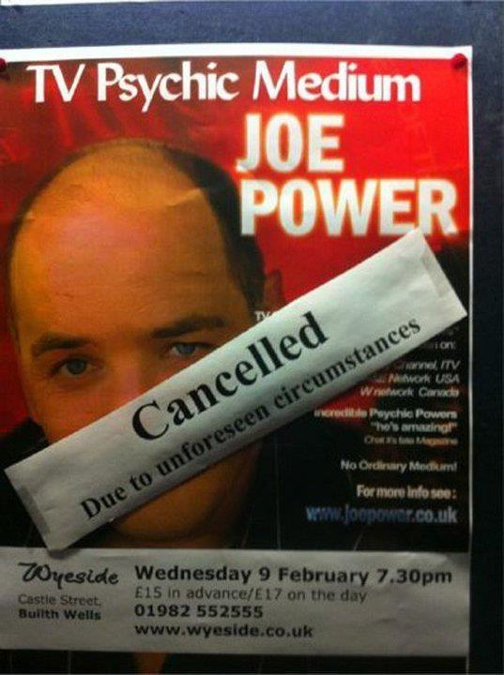
8

Slide 26
Day 3 Grammar Pattern
Use parenthesis to set off information that is not closely related to the main point of the sentence but provides an interesting detail, explanation, or illustration. In addition, place them around a acronym or abbreviation when introducing it after its full form.
Example: We might ask why affairs of state are classified as important and their discussants intelligent, while discussion of family interaction (what we disparagingly call “gossip”) is dismissed as idle chatter.

Slide 27
Sentence Correction
Copy the following sentence and correct if necessary.
Caesar Milan, the dog whisperer, has never met an incorrigible – what most would find downright impossible- dog to rehabilitate.

Slide 28
Thursday

Slide 29
Welcome Back
Make sure you have a pencil ready. Phones should be off desks and out of laps. Headphones out!
You will need your warm up.
Honors:
Standard:

Slide 30
Day 4 Grammar Pattern
A slash between words, as in and/or and he/she, indicates that either word is acceptable in the given context (there should be no space between the words and slash). Slashes are also used to mark line divisions in quoted poetry (there should be a space between the word and slash.”
Example: Wallace Stevens refers to the listener who, “nothing himself beholds / Nothing that is not there and the nothing that is.”

Slide 31
Day 4 Sentence Correction
Copy the following sentence and correct if necessary.
The president of the vigilant neighborhood watch group, wanted the man responsible for the recent break-ins prosecuted and / or jailed.

Slide 32
Warm Up Directions
Complete the following half sheet as practice for the quiz tomorrow. You will attach this to your warm up sheet tomorrow. You must have both to get full credit.

Slide 33
Friday

Slide 34
Welcome Back
Make sure you have a pencil ready. Phones should be off desks and out of laps. Headphones out!
You will need your warm up.
Honors:
Standard:

