Slide 1
Week 12 PPT

Slide 2
Monday, Nov. 13

Slide 3
Welcome
Honors – Clear desk of anything other than scantron and your Oedipus Rex Study Guide. Make sure to have something to write with.
Standard – Put your name and this week’s dates on the warm ups. If you did not submit your CRQ, do so now. Check name on board.
Make sure phones are away. This means off your desk, out of your lap, and no ear buds in.

Slide 4
When you finish your test……
Flip the test and answer sheet over. I will come around shortly; don’t stress.
There is an article on your desk that introduces the next unit. Read the article and answer the corresponding questions. This can be on the sheet of paper or on notebook paper.
You may listen to earbuds when you are finished with the test. However, set your music to shuffle and keep working. Do not play on your phone.
Do not speak to others, even for innocuous reasons like borrowing paper. Raise your hand and I can help you.

Slide 5
Part 1 Quiz
1. 205 | 6. 207-208 | 11. 214-215 | 16. 224 | 21. 224
2. 232 | 7. 214 | 12. 206 | 17. 227 | 22. 229
3. 205 | 8. 216 | 13. 208 | 18. 226 | 23. 206
4. 206 | 9. 221 | 14. 216 | 19. 231 | 24. 229
5. 207 | 10. 206 | 15. 221 | 20. 233 | 25. 216

Slide 6
Parts – pg. 237
Jocasta -
Stage Directions -
Messenger -
Choragos -
Oedipus -

Slide 7
Week 12 - Monday
Most singular nouns, indefinite pronouns, abbreviations, and acronyms require –’s to form the possessive case. Possessive pronouns (my, mine, our, ours, your, yours, his, her, hers, its, theirs, and whose) are not written with apostrophes.
Example:
The college student was sent to the dean’s office.
Japanese democracy is different from ours.

Slide 8
Sentence Correction
Copy the following sentence and correct if necessary.
The apathetic students were sent to the principals office.

Slide 9
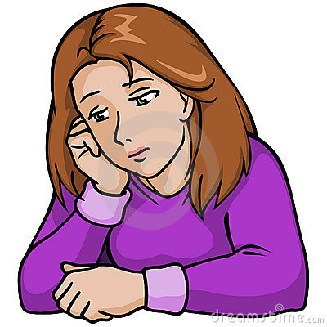
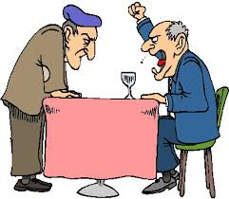
Vocabulary
Apathetic
Caustic
lacking interest, concern, or emotion
harsh, stinging; sarcastic

Slide 10
Tuesday, Nov. 14

Slide 11
Week 12 - Tuesday
Plural nouns ending in –s require only an apostrophe for the possessive form. Plural nouns that do not end in –s need both an apostrophe and an s.
Example:
The babies’ toys were scattered all along the day care.
Women’s health is a major topic for researchers today.

Slide 12
Sentence Correction
Copy the following sentence and correct if necessary.
The twins hopes for being crowned most popular in the yearbook were likely because they were held in great esteem by their peers.

Slide 13
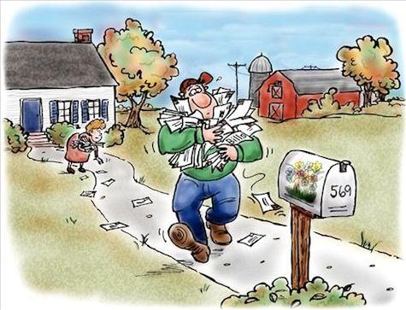
Vocabulary
Defer
Esteem
to submit or yield to another’s wish or opinion
to value highly, to respect

Slide 14
Wednesday, Nov. 15

Slide 15
Week 12
Double quotation marks set off direct quotations, including those in dialogue. Single quotation marks enclose a quotation within a quotation.
Example: According to Anita Erickson, “when the narrator says, ‘I have the right to my opinion,’ he means that he has the right to his own delusion.”

Slide 16
Sentence Correction
Copy the following sentence and correct if necessary.
‘Impetuous behavior in teenagers is on the rise writes the behavior analyst. The analyst stated, something must be done in order to save the lives of teens in America.

Slide 17
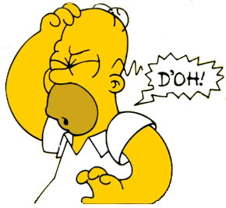
Vocabulary
Impetuous
Nostalgic
impulsive, unthinking
a bittersweet longing for the past

Slide 18
Thursday, Nov. 16

Slide 19
Week 12
Quotation marks enclose the title of a short work, such as a story, an essay, a poem, or a song. The title of a larger work, such as a book, magazine, movie, newspaper, or a play should be italicized.
Example: “The Green Shepard” first appeared in The New Yorker.

Slide 20
Sentence Correction
Copy the following sentence and correct if necessary.
The Odyssey by Homer is an epic poem about a versatile hero that struggles to return home after more than 10 years.

Slide 21
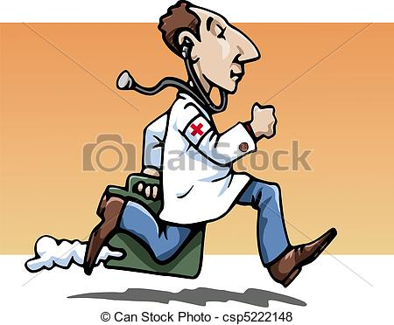
Vocabulary
Scrupulous
Versatile
thorough and careful
capable of doing many things competently

