Slide 1
Week 11 PPT

Slide 2
Week 2
Use commas to set off a nonessential word or word group: one comma separates a nonessential element at the end of a sentence ; two or more commas set off a nonessential element in the middle of a sentence.
Example: The Hilltop Folk Festival, planned for late July, should attract many tourists.

Slide 3
Sentence Correction
Copy the following sentence, correct if necessary, and identify the nonessential element.
Bill who has animosity towards his boss loss his job due to insubordination.

Slide 4
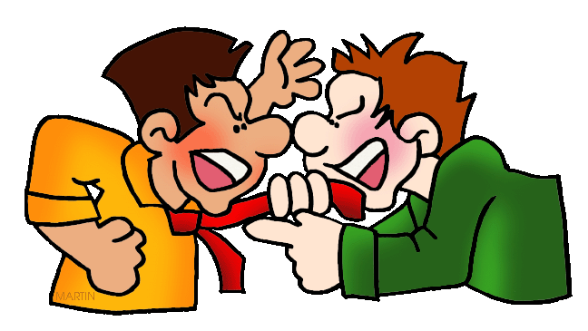
Vocabulary
Animosity
Cathartic
bitter hostility
emotionally cleansing or relieving.

Slide 5
Week 2
Commas set off sentence elements in which words such as never and unlike express contrast.
Example: A planet, unlike a star, reflects rather than generates light

Slide 6
Sentence Correction
Copy the following sentence, correct if necessary, and identify the contrasting elements.
The Liki language unlike the English language is an esoteric one around the world.

Slide 7
Vocabulary
Dearth
Esoteric
a scarce supply
understood by only a few

Slide 8
Week 2
An apostrophe, often followed by an –s, signals the possessive case of nouns.
Example: Mona Lisa’s smile is still studied and appreciated today.

Slide 9
Sentence Correction
Copy the following sentence and correct if necessary.
The doctors nonchalant attitude caused the patients mom to worry.

Slide 10
Vocabulary
Idiosyncratic
Nonchalant
peculiar to an individual
casually unconcerned (sometimes falsely)

