Slide 1
Week 10 PPT

Slide 2
Reminders
Bathroom Passes are distributed
PLAN – Nov. 8 – If you need a calculator, let me know.

Slide 3
Week 10 - Monday
A comma follows an introductory phrase. Remember that a phrase is a sequence of grammatically related words without a subject, predicate, or both.
Example: Despite a downturn in the national economy, the number of students enrolled in this university has increased.

Slide 4
Sentence Correction
Copy the following sentence, correct if necessary, and identify the introductory phrase.
Due to Brad’s capricious behavior his psychiatrist recommended that he be checked into the nearest facility.

Slide 5
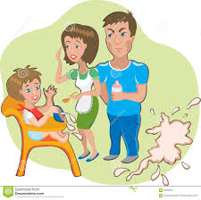
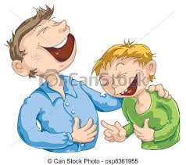
Vocabulary
Anecdote
Capricious
a short account of an interesting or humorous incident
impulsive, unpredictable

Slide 6
Week 10 - Tuesday
A comma often follows introductory words like interjections, vocatives (words used to address someone directly), or transitional words.
Example: Moreover, the design will increase efficiency in the office. (transitional word)

Slide 7
Sentence Correction
Copy the following sentence, correct if necessary, and identify the introductory word.
Wow his erudite responses during the debate single-handedly secured the win for his team.

Slide 8
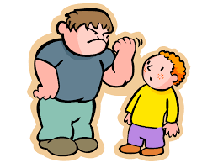
Vocabulary
Daunt
Erudite
to intimidate or lessen one's courage
scholarly, well educated

Slide 9
Week 10 - Wednesday
A series contains three or more parallel elements. Commas separate words, phrases, or clauses in a series. A comma appears after each item in the series except the last one.
Example: The company’s code of ethics encourages seeking criticism of work, correcting mistakes, and acknowledging the contributions of everyone.

Slide 10
Sentence Correction
Copy the following sentence, correct if necessary, and identify each part of the series.
The magnanimous celebrity donated money to charity took pictures with her fans and started a foundation in favor of underprivileged kids.

Slide 11
Vocabulary
Homogenous
Magnanimous
all of the same or similar kind
noble and generous in spirit

Slide 12
Week 10 - Thursday
Two or more adjectives that precede the same noun are called coordinate adjectives. Commas should be placed between coordinate adjectives.
Example: Crossing the rushing, shallow creek, I slipped off a rock and fell into the water.

Slide 13
Sentence Correction
Copy the following sentence, correct if necessary, and identify the coordinate adjectives.
Although he wasn’t a god Buddha was often venerated for his quiet peaceful spirit.

Slide 14
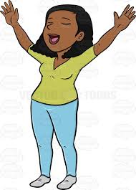
Vocabulary
Sanguine
Venerate
Cheerful
to respect

