Slide 1
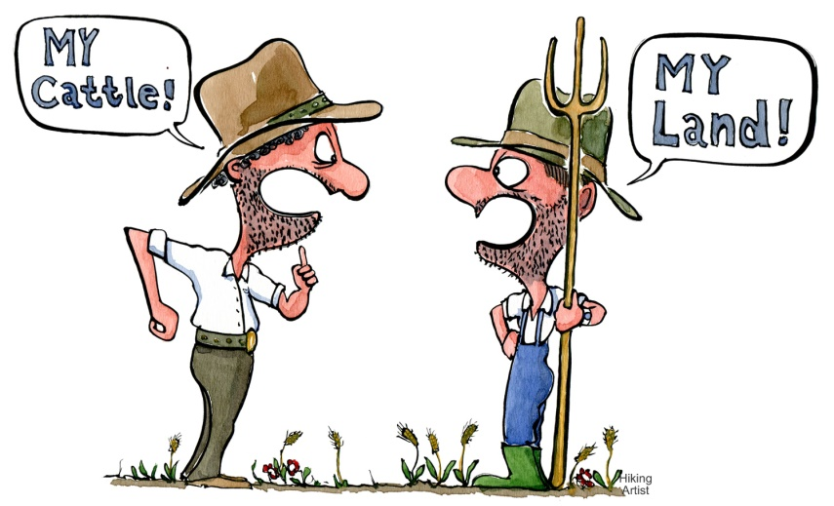
Review of conflict
Internal conflict (Man vs himself)- a conflict a character has within him or herself.
External Conflict (Man vs Man, Nature, machine, society)- a conflict a character has with an outside force such as another character or force of nature.

Slide 2
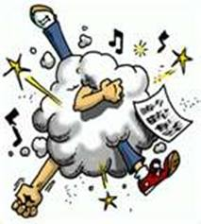
TWEET SHEET DIRECTIONS
Choose two of following characters and create tweets focusing on the conflict going on with that character right now in the play (by the end of scene 3):
- Oedipus
- Jocasta
- Choragos
- Messenger
On the lines provided, provide an appropriate twitter handle and a tweet that focuses on either an internal or external conflict. Please indicate in parenthesis whether or not the conflict is internal or external. Include a few appropriate hashtags as well.

Slide 3
Example of TWEET
Novel/ Story/ Text: Oedipus by Sophocles
Character Chosen: Creon
Chapter/Section: Part I
Tweet:
YBKing says: Why would Oedipus think I’d really want to be king? (external conflict with Oedipus)
#BrotherPower
#NoNeedForTheCrown
#PowerNoHeadaches

