Slide 1
Introduction to Chinua Achebe and Things Fall Apart

Slide 2
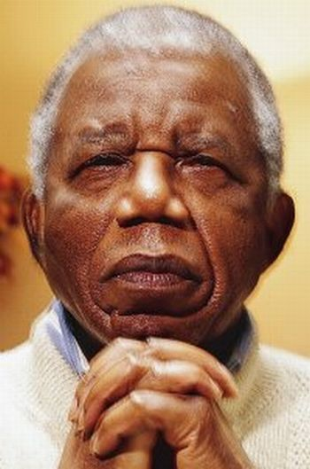
Who is Chinua Achebe?
Born Albert Chinualumogu Achebe in 1930 in Nigeria
Born to Ibo parents who were deeply Protestant; he was raised in the Protestant denomination
Highly educated, often wrote about world religion and traditional African culture.
With disappointment in his political ventures, he moved to the United States, where a car accident in 1990 left him paralyzed from the waist down.
Called the “father of African literature”

Slide 3
What was important to Achebe?
He wrote satirical and serious literature about waning African culture under European (British) colonization
He critiqued the corrupt Nigerian and British governments that controlled the Ibo people
He criticized the unstable Nigerian government. Some of his stories featured army coups initiated by sexual politics
The use of the English language as a replay of African colonization
Oral tradition, such as folk tales and songs, and verbal descriptions of life and life lessons—Achebe tried to keep alive important aspects of the Ibo culture in his writing
Family and relationships in the light of African colonization were a large part of Achebe’s literature
Politics and African colonization
African Culture, Family, and Tradition

Slide 4
About what did Achebe write?
Achebe looked at the African experience under white Christian colonialism as a “systematic emasculation of the entire African culture” (Nigerian professor Ernest N. Emenyonu).
Urban development threatens African traditions.
Important: He tries not to take a side; he remains as neutral as possible in his writing, attempting to avoid absolutes and hyperbole.
African Colonialism and Culture

Slide 5
About what did Achebe write?
Many of his main characters portray a traditional, patriarchal Igbo (Ibo) society.
Men take numerous wives
Women are beaten regularly
It has been argued that the presence of such masculinity is simply a description of the society from which he comes, and can be seen as an indictment of those gender roles.
Some of his female characters represent balance, and go against the regular male character that shuns femininity as a bad thing.
Masculinity and Femininity

Slide 6
Things Fall Apart (1958)
Tells the story of Okonkwo, an overly masculine leader and wrestling champion in the fictional Nigerian village of Umuofia.
Focuses on Okonkwo, his wives and children, the Igbo (Ibo) community in which he lives, and the white missionaries who attempt to introduce Christianity to the Igbo culture.
Uses superstition and folklore to tell Okonkwo’s sad story; his life takes a wrong turn after he participates in a terrible crime in order to avoid looking effeminate.

Slide 7
Historical Context- Tribal Society
Story takes place in the tribal village of Umoufia in the late 1880’s, prior to English colonization
The Ibo worship many gods who are represented by priests and priestesses within the tribe
Each individual has a personal god, or chi, that directs his actions
The Ibo are a hunting and gathering society with yams as the primary crop

Slide 8
Tribal Society (Continued)
People in the village are grouped according to family, and the eldest male member holds the most power
Large emphasis on tribal traditions and rituals
Village concerns, including legislation, were handled by tribal councils
System encouraged hard work and the spread of wealth
In the novel, Umuofia is respected and feared by other villages

Slide 9
Historical Context- the spread of Christianity
Christianity took its strongest hold in Africa when the majority of the missionaries arrived in the late 1800’s
Missionaries provided education and attempted to convert tribes from their “heathanistic” beliefs
Africans were distrustful of European Christians at first, but many eventually converted
As more members adopted European values, the clans divided and conflicts arose

Slide 10
Historical Context- English Colonization
After the arrival of the British, conflicts between villages were resolved by white governmental rules
When violence involved missionaries or bureaucrats, British soldiers would often slaughter entire villages instead of punishing guilty individuals
Africa changed from a society determined by common language and cultures to a land divided by political borders that divided it into at least 50 nation states

Slide 11
Colonization- (Continued)
The divisions split ethnic groups which led to tension and sometimes violence
British colonial rule in Nigeria lasted from 1903 to 1960
On October 1, 1960, Nigeria was granted status as a sovereign state and member of the British Commonwealth, but was still under the rule of the British monarchy
In 1963 a new constitution replaced the British monarch with a Nigerian president

Slide 12
Compare and Contrast
1800’s- before colonization, language & geography separate African societies
Colonial Africa- Africa is divided into more the 50 nation-states with no regard to common languages or traditions
Today-Societies are no longer clear cut. There is more opportunity for education & improved means of transportation & communication. Societies have become mixed, but ethnic conflicts still sometimes lead to violence

Slide 13
Compare and Contrast
1800’s- religion varies, but most Africans share some common beliefs and practices
Colonial Africa- Missionaries arrive and introduce Christianity; many tribesmen convert
Today-more than 25% of Africa is Christian, but traditional African religion is still practiced, as well as Islam

Slide 14
Compare and Contrast
1800’s- Africans have their own identities and cultures; there is little interest in participating in the modern world
Colonial Africa- African children are taught European history so they can compete in the modern world; their own heritage is ignored
Today-There is a renewed interest in cultural heritage, and traditional customs are being taught to African children

Slide 15
The Structure of Things Fall Apart
It is a modern Greek tragedy!
Follows a tragic hero, who is a great or virtuous character, destined for a downfall.
Shows Okonkwo’s hamartia, or character flaws.
Hubris (pride)
Ate (rashness)
These character flaws lead to peripeteia, or reversal of fortune.

Slide 16
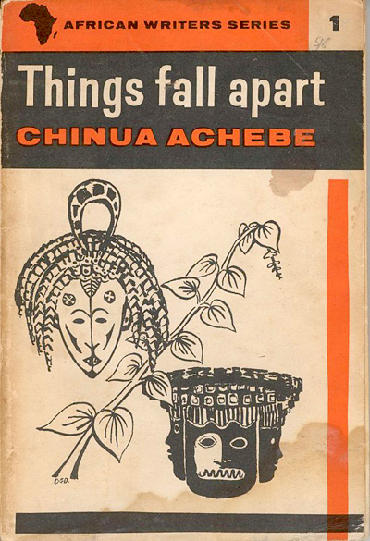
Themes in Things Fall Apart
Different cultures are not necessarily unequal; this superior/inferior belief will lead to eventual tension and destruction of both cultures.
Cultures are dynamic; they must be flexible and evolve with changing outside forces.
Masculinity and femininity should not be viewed in very strict terms. Such cut and dry perspective does not allow a person to adapt to their surroundings.
Success and failure are self-determined. We as human beings define them, in our own individual terms, as suited to our needs, values, and cultural experiences.
The struggle between change and tradition
The role of religion in a societal structure

Slide 17
How was the book received?
Achebe had trouble even getting it printed, at first.
He paid for it to be printed, the business in London did not do it until his boss went and ensured its printing.
Some agents said there was no market for African writers and literature, but Achebe kept trying.
After this obstacle, it was published soon after and reached critical acclaim across the United States and Europe.

