Slide 1
Symbols in Siddhartha
Hickman, Jones, MacDonald

Slide 2
Symbol Analysis
Symbols
Buddha’s smile
Caged Bird
Kamala’s lips
Groves
Jetavana
Kamala’s
River
Snake
Directions:
On a piece of poster paper, divide into 6 sections. You are in groups no larger than 4.
1. For each symbol explain its significance within Siddhartha’s journey. Think about his relationship with the spiritual or material world throughout his journey.
2. Then, find a textual evidence (a quote) to support your explanation of the symbol.
Draw a creative interpretation of this symbol

Slide 3
Example Analysis - Children
In “Siddhartha,” the symbol of a child is used in many respects both by Siddhartha describing himself as well as him describing others; it does not represent age, but a mindset. First, Siddhartha sees himself as a child who rejects his teachers, the Samanas and Gotoma Buddha (Chs. 2 – 3). This shows him symbolically rejecting that he is a child of religion in the spiritual world and he chooses to be his own teacher, and an adult. Then, during Siddhartha’s time in the city as a merchant, he describes the goals and pursuits of the villagers, in the “material world” as childish. According to Siddhartha, “he did not learn from them, these child-like pleasures and follies,” (78). Once again, Siddhartha sees others who follow, and are not enlightened as children and when he leaves at the end of the chapter, Samsara, he, once again, symbolically tries to break from being a child to being an adult. In both the spiritual and material world, a child symbolizes those who follow shallow ideas and who have not reached a great depth of understanding; Siddhartha frequently tries to stop being a child.

Slide 4
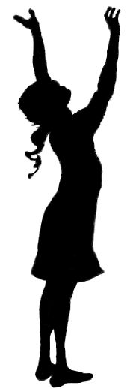
Relevant Symbol Interpretations

