Slide 1
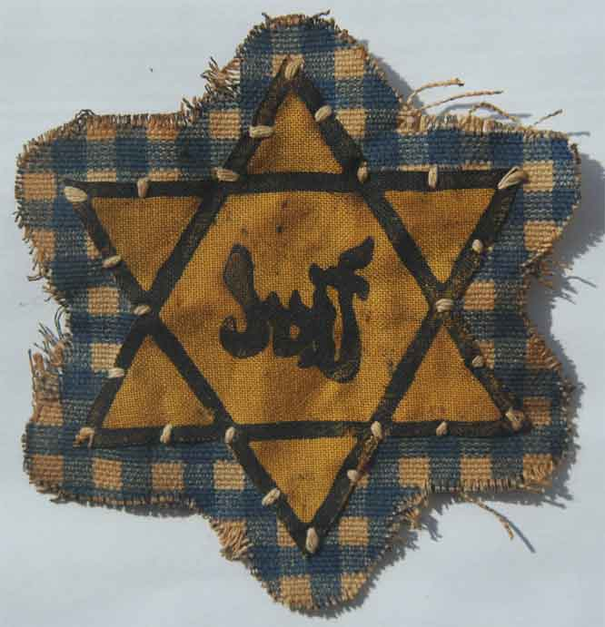
Characters In Night

Slide 2
Instructions
Choose a character from chapter 1 (Elie or Moishe)
Write 1-2 sentences of who this character is and the part they played in Wiesel’s Night.
Draw a symbol to illustrate this character.
Write a paragraph (7-10 sentences) explaining why this character is important in the story
USE QUOTES FROM THE BOOK

Slide 3
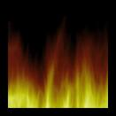
Example
Madame Schächter
Madame Schächter was a woman who lost her husband and sons when her family was being deported.
On the cattle wagon she began to scream, “Fire, I see a fire!” Madame Schachter has visions of fire. This scene foreshadows the fate of the Jews on the train, as many of them would be sent to the crematorium…

Slide 4
Chapter 2 Response question
For Chapter 2 response, describe the character of Madame Schachter.
Write 2-3 sentences describing her.
Draw a symbol representing her
Write a paragraph (7-10) sentences describing the incident on the train. Does she hallucinate the flames or is it a vision? What happens to her after she begins screaming? Why did Wiesel choose to include this incident in Night?

Slide 5
Chapter 3 Response
Draw an image of Elie that represents him before he is sent to Aushwitz AND draw a symbol that represents Elie at this time in the camp.
How has Elie changed in such a short time? Has his beliefs changed? What is his worldview now? What actions or inactions does Elie make?
Write a paragraph (7-10) Sentences describing Elie’s change. Use quotes and scenes from the book

Slide 6
Chapter 5 Response: Character Portrait
Write down at least 3 examples for each of the following:
Elie
Wiesel
Sees
Hears
Does
Feels
Goes
Thinks
Loves
Says
Fears
Believes
You may draw Wiesel’s character or use a magazine cutout.
Write a one page response analyzing how Elie has changed as a result of witnessing and experiencing the Holocaust. You must cite at least 3 examples from the play.
Write the examples in your own words.

Slide 7
For example:
“I too had become a different person. The student of the Talmud, the child that I was, had been consumed by flames. There remained only a shaped that looked like me. A dark flame had entered my soul and devoured it.”
You must locate two more quotes.

Slide 8
Response for Chapter 4
When Elie sees the young boy being hanged, Elie believes that God is no longer there, or dead. The hanging of the boy symbolizes the hanging of God.
Draw a symbol that shows Elie’s loss of faith
Find 5 instances or scenes from Night where Elie questions his faith in God and humanity. Write them in your book and the page numbers. (example: Elie sees the babies thrown in the pit. P. 33)

