Slide 1
Siddhartha Discussion

Slide 2
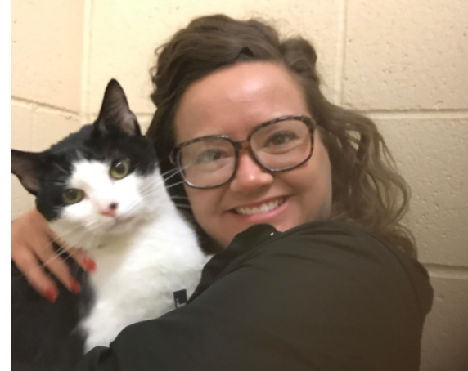
1st Period Password: oreo
Oreo
Directions
Create a group of no more than 3. You can pick your group.
Head to hickmak.wordpress.com and find the post about 1st period discussion questions. You will need to input the
Talk about your answers on the seven questions. Give complete ideas, use quotes when necessary.
Take turns posting your answers for each question. Note your group number, you can make a group name. Click reply to my post. Use smartphones to complete this
You most likely won’t see other posts since I have to “approve” them
Group 1 – Jackson, Ava, Ronan (outside)
Group 2 – Giana, Hannah, Rachael (outside)
Group 3 – Ashley, Leah
Group 4 – William, Jaden, Jack (outside)
Group 5 – Avilon, Grace, Jay-Za
Group 6 – Zanijha, Chastity, Jade
Group 7 – Jayna, Farrah
Group 8 – Sammie, Cassidy, Isabel (outside)
Group 9 – Snoop Dog –Collin, Ben
Group 10 – Austin, Jordan (outside)

Slide 3
3rd Period Password: reese
Reese
Directions
Create a group of no more than 3. You can pick your group.
Head to hickmak.wordpress.com and find the post about 3rd period discussion questions. You will need to input the password
Talk about your answers on the seven questions. Give complete ideas, use quotes when necessary.
Take turns posting your answers for each question. Note your group number, you can make a group name. Click reply to my post. Use smartphones to complete this
You most likely won’t see other posts since I have to “approve” them
Group 1 – Joseph, Valerie M and J (outside)
Group 2 – Caroline, Katherine (outside)
Group 3 – Briana, Jackie, Jada (outside)
Group 4 – Jacob, Chris L., Ian (outside)
Group 5 – Maddie, Beatrice, Chris S.
Group 6 – Chayse, Niheira
Group 7 – Claire, Hamdi, Nick (outside)
Group 8 – Ethan, Jack F.
Group 9 – David, Zac
Group 10 – Gabe, Camille, Storm

Slide 4
6th Period Password: lily
Lily
Directions
Create a group of no more than 3. You can pick your group.
Head to hickmak.wordpress.com and find the post about 6th period discussion questions. You will need to input the password
Talk about your answers on the seven questions. Give complete ideas, use quotes when necessary.
Take turns posting your answers for each question. Note your group number, you can make a group name. Click reply to my post. Use smartphones to complete this
You most likely won’t see other posts since I have to “approve” them
Group 1 –
Group 2 –
Group 3 –
Group 4 –
Group 5 –
Group 6 –
Group 7 –
Group 8 –
Group 9 –
Group 10 -

