Slide 1
Siddhartha
By: Hermann Hesse

Slide 2
Yoga
Yoga: one of the six classic systems of Hindu philosophy that focuses on bodily control and the magical powers obtained by its devotees
Goal: to achieve liberation from the limitations of flesh, delusions on sense, and pitfalls of thought; achieve union with the object of knowledge (God or self)
Eight stages: self-control, religious observance, postures, regulation of breath, restraint of senses, steadying of the mind, meditation, profound contemplation/liberation
Liberation rarely can be attained in one lifetime (several births often needed).

Slide 3
Archetypes
Trimurti: (Brahma: Creator; Vishnu: Protector; Shiva: Destroyer/Preserver)→ Polytheism
Trinity in Christianity: (Father: Creator; Son/Jesus: Savior/Redeemer; Holy Spirit: Sanctifier/Helper) → Monotheism
Indian culture also believes in a continual cycle of growth, destruction, and rebirth like other myths like: “The End of All Things,” “The Wooden People,” “The Metamorphoses,” etc.

Slide 4
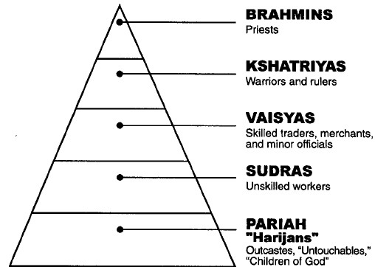
Caste System

Slide 5
Caste System
Brahmins: teachers, spiritual leaders, priests (the “head”)
Kshatriya: rulers and warriors (the “hands”)
Vaishya: merchants, farmers, and artisans (the “thighs”)
Shudras: menial work, servants (the “feet”)
Untouchables: clean up dead animals and human waste (not a part of the primal man)

Slide 6
Caste System
Untouchables were abolished in India in 1949
- Gandhi called the untouchables “children of God” and
helped influence legal action.
- The caste system greatly influenced marriages,
careers, friends, etc in India.
- In modern India, the situation is complex and intercaste mobility and marriages are common, especially in cities.

Slide 7
Hinduism
Important Characteristics:
- Maya: the material world is illusory
- Samsara: the world of material existence and the
passing of souls from one life to another
- Karma: an individual’s fate in the cycle can be altered by good or evil actions
- Dharma: righteousness and justice found in social and
moral laws; focusing on duty and obligations instead of personal satisfaction.

Slide 8
Buddhism
Founded by Siddhartha Gautama in the 500’s B.C.E.
Four Noble Truths:
1. Sorrow of existence
2. Desire for sensual delights causes suffering
3. Suffering can be ended through extinction of desire
4. Following the “eightfold noble path” is the way to salvation

Slide 9
Buddism
Eightfold Noble Path
Right Speech
Right Occupation
Right Action
Right Effort
Right Mindfulness
Right Concentration
Right Belief
Right Intention

Slide 10
Hinduism and Buddhism
Neither Hinduism nor Buddhism are monotheistic, but many followers focus their worship on one divinity:
Hinduism: Either Siva, Vishnu, Krishna, or Mahadevi (Great Goddess)
Buddhism: Buddha is not a god, but inspires veneration.
Some historians believe that Buddhism began as a reform movement within Hinduism and then evolved into a separate religion

Slide 11
Hermann Hesse
Born in 1877 in Calw, Germany
Father was a religious journalist, publisher, and missionary. He wanted his son to pursue the ministry.
Experienced a religious crisis and fled the seminary in 1891. He also attempted suicide.
Wrote antiwar tracts during World War II. Became a student of psychology:
- studied Freud, was psychoanalyzed by Jung (he was a patient in a sanitarium).
Won a Nobel Prize in 1946 for his literature.
Died of a brain hemorrhage in 1962.

Slide 12
Brief Psychoanalysis
Freud:
-Id: the pleasure principle; cares only about itself and getting what it wants (THE DEVIL).
- Ego: the reality principle; understands needs of others and meets the needs of our impulses (id) and our conscience (superego) (YOUR MIND AND HEART).
- Superego: the conscience; develops due to moral and ethical constraints; right vs wrong (THE ANGEL).
ID Superego
EGO (maintains balance)

Slide 13
Jung’s Theory
Self-realization: the final stage of development
- Focused on the study of the unconscious (dreams, art, religion, etc.) to reconcile the individual’s consciousness with the world
- To complete the individualization process, one must go beyond the ego and pay attention to dreams, religion, and spirituality while questioning the views of society

Slide 14
Siddhartha
Published in 1922
It offended many readers who believed it glorified sex and drug addiction.
Novella: a short novel
Bildungsroman: a novel that portrays the growth/education of a young protagonist as he or she faces moral and/or intellectual crises that prepare him or her for adult life
Allusions: refers to other works (myths, practices, terminology, social structures, and sacred scriptures or Hinduism, Buddhism, and Christianity.)
Allegory: symbolic representation of certain truths about human existence
Part 1: Siddhartha’s young manhood
Part 2: Siddhartha’s middle age, the beginning of his old age, his final path to spiritual enlightenment

Slide 15
Vocabulary
Ablutions: acts of ritual washing
Ascetics: people committed to self-denial and spiritual discipline
Alms: charitable gifts to the poor
Siddhartha: same given name as Buddha
** Although Siddhartha’s renunciation of privilege for asceticism parallels Buddha’s life, he is a different individual. Hesse’s Siddhartha pursues his own path to enlightenment. He respects Buddha, but ultimately rejects Buddha’s practices for his own.**

