Slide 1
Public Statement Directions

Slide 2
Underline words that you feel reveal the clergymen’s tone towards the protests/unrest. In the margins explain their tone/attitude. (Paragraphs 1 – 3)
What is the clergymen’s claim or argument? Annotate this to the side.(Paragraph 3)
What do the clergymen think should happen? (Paragraph 4)
Contrary to what Ghandi feels about civil disobedience, what do the clergymen feel civil disobedience leads to? Annotate. (Paragraph 5)
Who is commended, or thanked, in paragraph 6? Extension - How may this be antithetical to what you have learned in previous classes? Explain in the margins.
What solution do the clergymen propose in paragraph 7? Annotate.

Slide 3
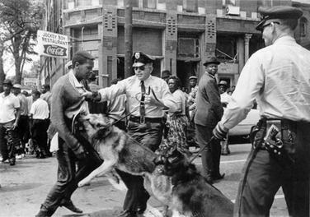
Bill Hudson's image of Parker High School student Walter Gadsden being attacked by dogs was published in The New York Times on May 4, 1963.

Slide 4
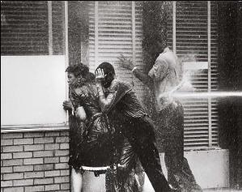
Charles Moore, represented by the Black Star photo agency - http://digitaljournalist.org/issue0309/lm04.html

Slide 5
