Slide 1
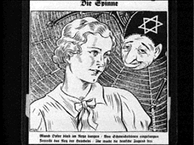
“The Spider”
This cartoon appeared in the 26th edition of an anti-Semitic weekly newspaper in 1934. It reads, "The Spider. Many victims are trapped in the web, caught by flattering words. Rip the web of deceit and free German youth."

Slide 2
"Behind the enemy powers: the Jew."

Slide 3
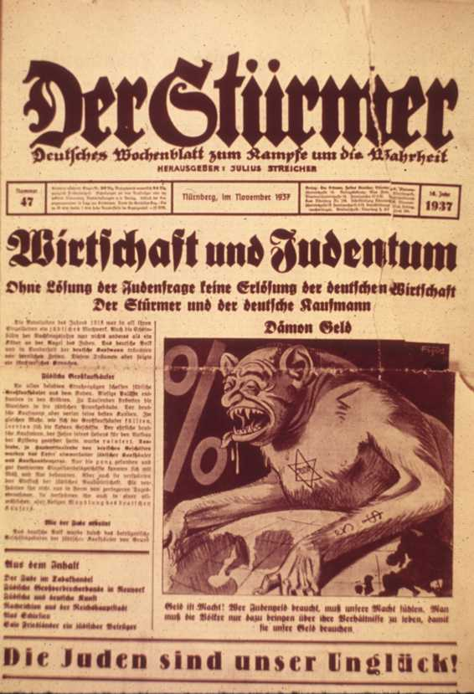
“Illustrating the Jew as a devil ”

Slide 4
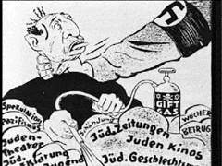
“Jews Poison” "Just wait, we'll put a stop to your dirty tricks."

Slide 5
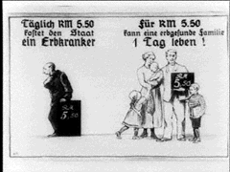
“Weakness Costs”
Daily cost to the state of maintaining one chronically ill person could be better spent
supporting an entire healthy German family.

