Slide 1
HOW TO WRITE CONSTRUCTED RESPONSE ANSWERS…
…and not lose your mind!

Slide 2
What are constructed response questions?
Some people call them essay questions.
They require you to write at least one paragraph.
Sometimes you have to use old information in a new, creative way.

Slide 3
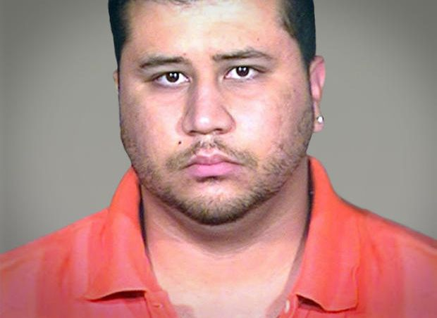
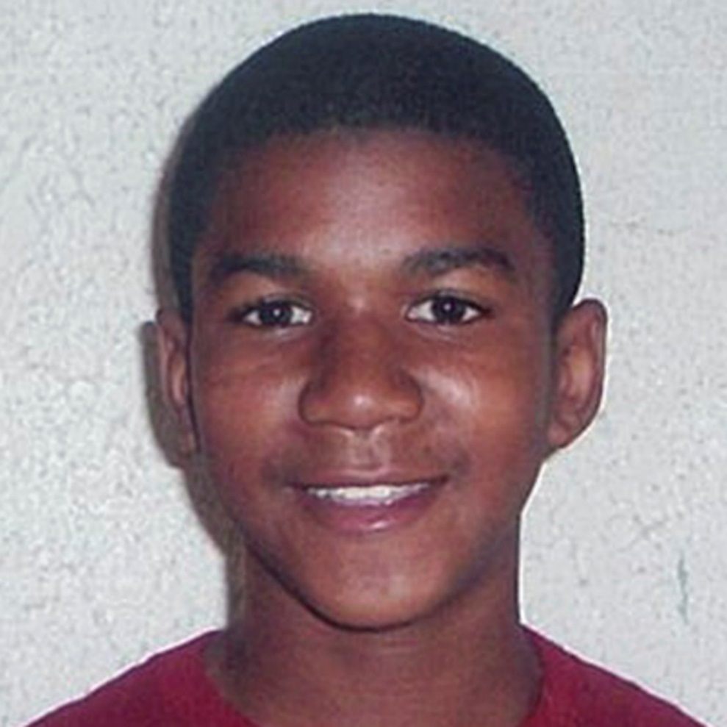
Review – Who are Trayvon Martin and George Zimmerman?

Slide 4
Question: Was the verdict rendered to George Zimmerman concerning the murder of Trayvon Martin justified? Should it be re-opened? Analyze the sources available and discuss your reasoning.
Carefully read the question.
Look for key words like
EXPLAIN DESCRIBE
COMPARE CONTRAST
DISCUSS ANALYZE

Slide 5
Danger! Danger!
Never make a list for an answer to a constructed response question!

Slide 6
Now you’re ready to begin your answer.
R-Restate or reword question
Reword question for topic sentence or thesis statement
Include title and author of work being discussed OR other details pertinent to the text/argument. Also called background information

Slide 7
Thesis statement example
Question: Was the verdict rendered to George Zimmerman concerning the murder of Trayvon Martin justified?
Thesis statement: In regards to the verdict rendered to George Zimmerman concerning the murder of Trayvon Martin being justified, it is clear that …….. _________________________________________________
R-Restate/reword

Slide 8
Answer the question…
Goes into the same sentence and makes up your thesis……
In regards to the verdict rendered to George Zimmerman concerning the murder of Trayvon Martin being justified, it is clear that it was unjustified and the verdict should be reversed due to an overlook in Florida’s laws and present interviews with jury members who have changed their minds.

Slide 9
Cite:
Use evidence from the text to support your answer. Cite specific lines or details from the work. MAKE SURE TO CITE!
First, it is clear that Zimmerman is guilty because is did fact break laws concerning stalking and intention. According to the laws In Florida: "A person who willfully, maliciously, and repeatedly follows [or] harasses ... another person and makes a credible threat to that person commits the offense of aggravated stalking, a felony of the third degree." (Fla. Stat. § 784.048.) (“How Zimmerman Could…”).

Slide 10
Explain- how your reasons support your answer.
It is established in testimony and through the recorded phone calls that Zimmerman’s actions violate this statute. He willfilly followed Martin down the street and is even told to stop by the 911 operator. Zimmerman’s decisions and refusal to stop clearly shows that he violated a Florida statute which should re-open the case.

Slide 11
Summarize
Write an ending sentence the asserts your claim. You can start your last sentence by using these words:
In conclusion As a result
Consequently Therefore
Therefore, due to violation of other Florida laws and resulting interviews from juries, it is clear that the Zimmerman case, while closed in court, should be reopened. There should be justice for Trayvon.

Slide 12
In 2013, George Zimmerman was found not guilty in a Florida courtroom for the murder of teen Trayvon Martin. Zimmerman, a neighborhood watch officer, claimed he had killed Martin in self-defense because he thought he had a gun which was found to be incorrect. In regards to the verdict rendered to George Zimmerman concerning the murder of Trayvon Martin being justified, it is clear that it was unjustified and the verdict should be reversed due to an overlook in Florida’s laws and present interviews with jury members who have changed their minds.
First, it is clear that Zimmerman is guilty because is did fact break laws concerning stalking and intention. According to the laws In Florida: "A person who willfully, maliciously, and repeatedly follows [or] harasses ... another person and makes a credible threat to that person commits the offense of aggravated stalking, a felony of the third degree." (Fla. Stat. § 784.048.) (“How Zimmerman Could…”). It is established in testimony and through the recorded phone calls that Zimmerman’s actions violate this statute. He willfully followed Martin down the street and is even told to stop by the 911 operator. Zimmerman’s decisions and refusal to stop clearly shows that he violated a Florida statute which should re-open the case.

Slide 13
Second, in an anonymous interview with jury member B29 after the trial, they admitted to feeling to disagreeing with the verdict. In an interview with ABC News, Juror B29 stated, “"You can't put the man in jail even though in our hearts we felt he was guilty…..but we had to grab our hearts and put it aside and look at the evidence,” (Newcomb). The jury member clearly states they felt Zimmerman was guilty but could not break the rule of the law. However, as mentioned previously, it has been established that Zimmerman did break Florida statute. With this this revelation, it is clear the jury was not completely informed and did not vote with their conscience. This means the verdict of “not guilty” was tainted and should be reviewed.
Therefore, due to violation of other Florida laws and resulting interviews from juries. It is clear that the Zimmerman case, while closed in court, should be reopened. There should be justice for Trayvon.

Slide 14
On the index card, tell me what you are going to argue and what you think your argument will be. Ex – Civil Unions should be legal. Ex. Body cams should be required for police officers.

Slide 15
HW
Finish questions tonight, 1 – 14 on the Martin CRQ.

